Slide 1
Weathering
Ch. 12

Slide 2
Chemical & Mechanical Weathering
Weathering - the breakdown of rock.
Mechanical (PHYSICAL) Weathering – breakdown of rock into smaller pieces by natural agents.
Chemical Weathering – breakdown or disintegration of rock by chemical reactions.

Slide 3
Rate of Weathering
What affects the rate of weathering?
Surface exposure – how long is the rock exposed to the elements (wind/water)?
Composition of Rock – what minerals is the rock made of? (Some minerals weather at different rates)
Climate – certain climates promote different types of weathering
Wet climates favor chemical weathering (tropical)
Dry climates favor mechanical weathering (deserts)

Slide 4
Mechanical & chemical Weathering foldable

Slide 5
Methods of mechanical weathering

Slide 6
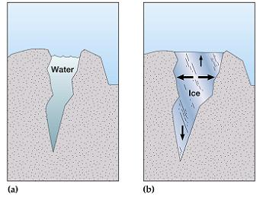
Mechanical Weathering: ICE/WATER
Frost/ice wedging – water gets into cracks, freezes and expands, thaws and contracts.

Slide 7
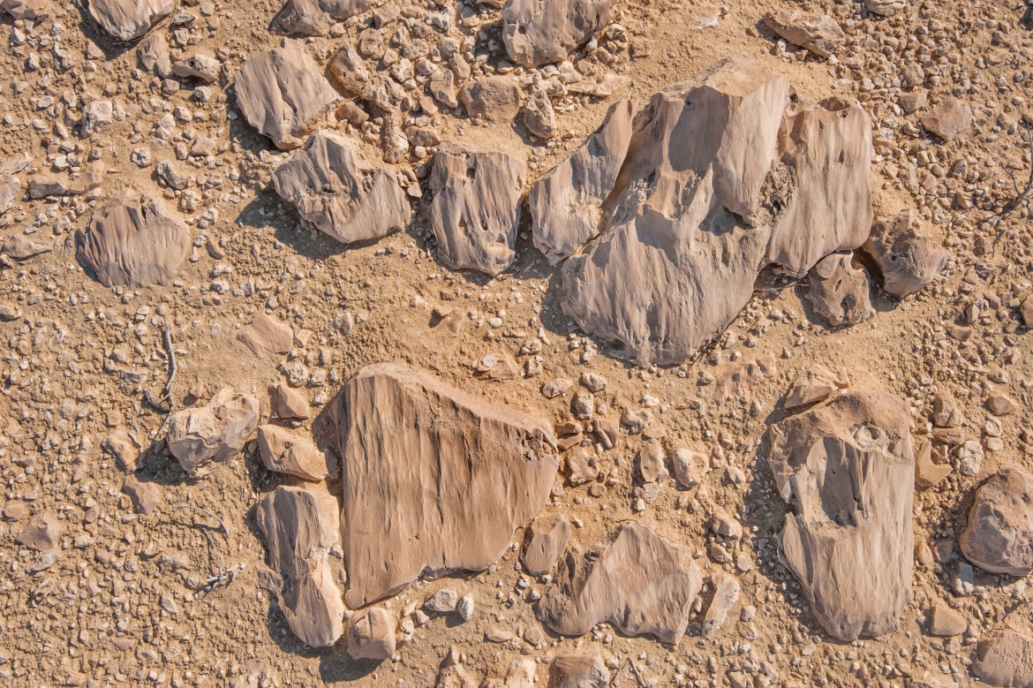
Mechanical Weathering: ABRASION
Water, wind, ice, and gravity move rock. As they scrape against surfaces and move against each other they SCRAPE and wear them down.
“SANDPAPER”

Slide 8
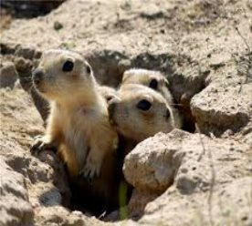
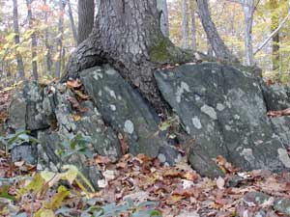
Mechanical Weathering: PLANTS/ANIMALS
Root wedging - plant roots grow into rock and break them.
Animals burrow into cracks of rocks and break them.

Slide 9
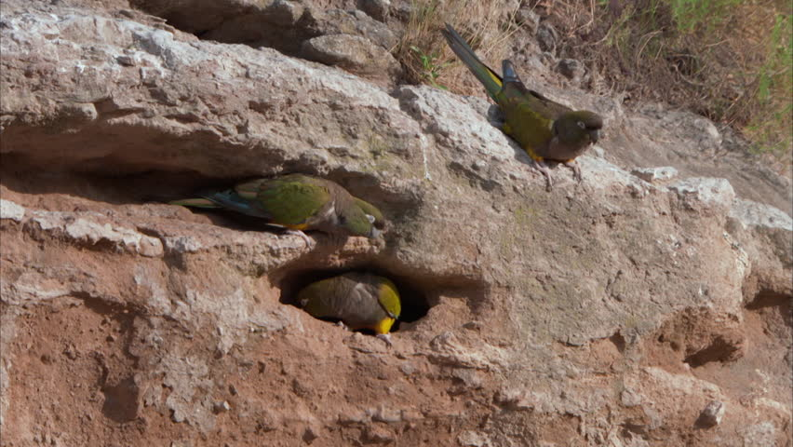
Animals weathering rock.

Slide 10
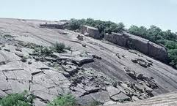
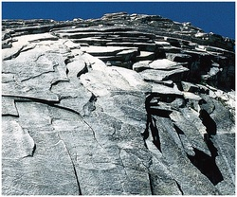
Mechanical Weathering: UPWARD EXPANSION
Uplift – upward force inside earth, causes rock to break in layers parallel to surface known as exfoliation.
Thermal expansion – rocks are heated, expand and contract, peeling off layers.

Slide 11
Methods of chemical weathering

Slide 12
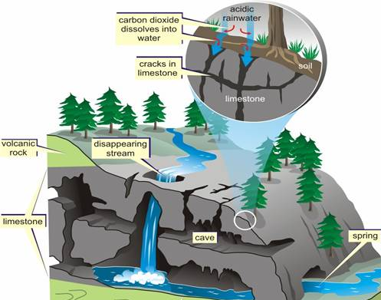
Chemical Weathering: CARBONATION
Carbonic acid (common acid dissolved in water) seeps through the ground and dissolves certain minerals. Dissolves CALCITE completely!
CALCITE is in limestone and marble.

Slide 13
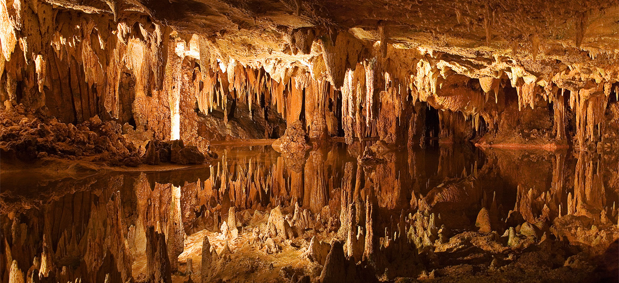
Luray Caverns, VA

Slide 14
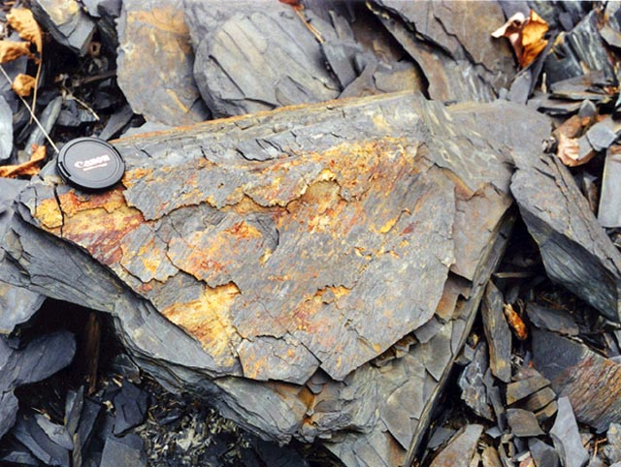
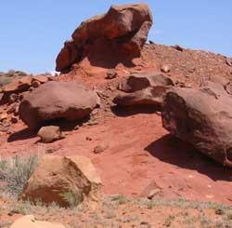
Chemical Weathering: OXIDATION
Chemical reaction of OXYGEN (O) with other substances, especially IRON (Fe).
When O + Fe = rust.

Slide 15
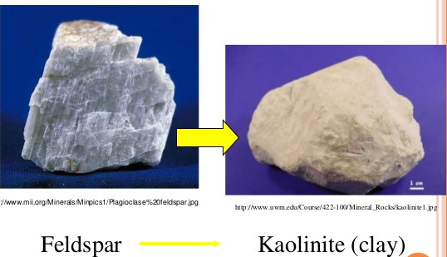
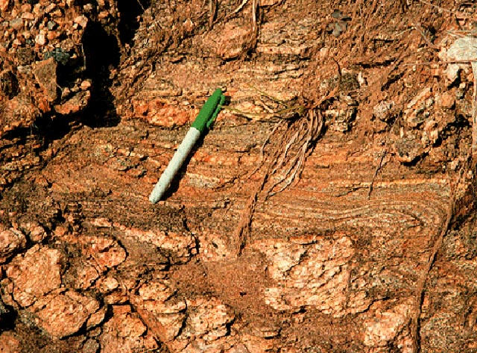
Chemical Weathering: HYDROLYSIS
Water reacting with minerals by dissolving the ions in them and reacting with the water to form clay minerals.
(FELDSPAR)

Slide 16
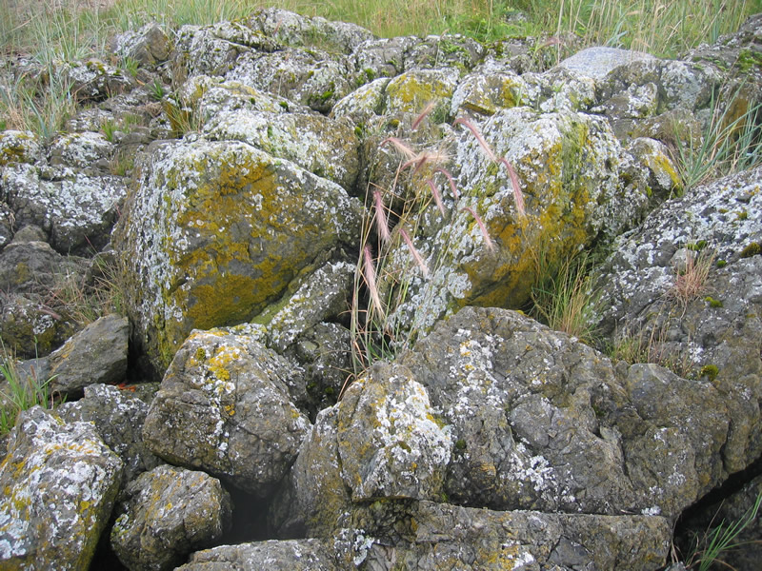
Chemical Weathering: BIOLOGIC BREAKDOWN
Plants/animals sometimes secrete acid which can chemically weather rock.
Moss/lichens

