Slide 1
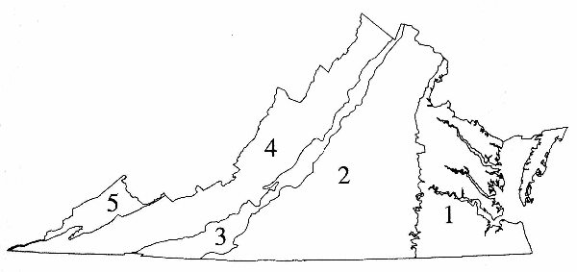
Virginia Provinces

Slide 2
Coastal Plain
Flat land underlain by sediments (youngest).
The sediment was produced by erosion of the Appalachian Mountains and deposited on the Coastal Plain. (marine fossils)
Eastern Shore
Minerals: sand, clay, gravel, titanium
Industry: Fishing (seafood), shipbuilding, military, tourism.

Slide 3
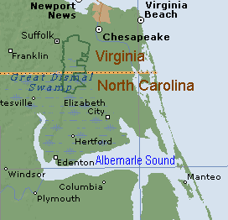
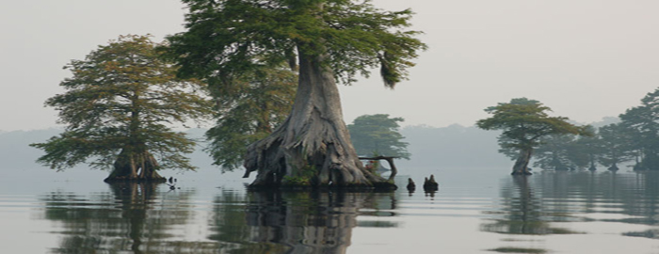
The Great Dismal Swamp
is a marshy area in the Coastal Plain Region of southeastern Virginia and northeastern North Carolina, between Norfolk, Virginia, and Elizabeth City, North Carolina

Slide 4
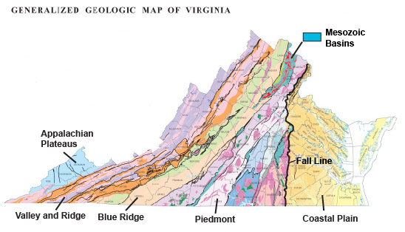
Fall Line
The Fall Line is a line of small waterfalls and rapids separating the Coastal Plain and Piedmont region.

Slide 5
Piedmont
Rolling hills underlain by ancient igneous and metamorphic rocks. These rocks are the roots of volcanoes formed from subduction before the Appalachians formed.
Minerals: Kyanite, gold, pyrite
Rocks: Slate
Industry: Technology, Textiles, Farming, Federal and State government, Tobacco.

Slide 6
Blue Ridge
Oldest rocks in the state. Approximately 1 billion years old. Igneous and metamorphic rocks. Some metamorphism occurred during the formation of the Appalachians.
Highest mountain: Mount Rodgers 5,719 ft.
Minerals: Copper, Iron, turquoise
Rocks: Granite
Industry: Recreation, farming

Slide 7
Appalachian Plateau
Rugged, irregular topography over sedimentary rocks. Plateaus are separated by faults. Most of Virginia’s coal resources are here. (marine fossils)
Plateau – land that is elevated and relatively flat.
Minerals – Coal, petroleum, natural gas
Industry – Coal mining

Slide 8
Valley and Ridge
Long, parallel ridges (sandstone) and valleys (shale, limestone, dolostone) over folded and faulted sedimentary rocks.
The folding and faulting occurred during a collision between Africa and North America. This collision produced the Appalachian Mountains. (marine fossils) Erosion has formed valleys.
Karst Topography – Caves, sinkholes, lost rivers.
Minerals – lime, lead, iron
Industry – Farming (poultry, apples, dairy), lumber

