Slide 1
The Scientific Method
Process or way to investigate phenomena, obtain new knowledge, correct errors and mistakes, solve a problem, and test theories

Slide 2
Ask a Question/State the Problem
What exactly is causing a person to be curious, to know more about a topic?
Ex: Why did this tomato plant grow the tallest?
Make observations

Slide 3
Research
Get background information on the topic you want to know more about/experiment.
This will help you come up with a hypothesis and design an experiment.

Slide 4
Hypothesis
Make an EDUCATED GUESS to answer the questions you are asking.
If, then statement:
If I do this…., then this will happen…….
If I water this plant 1 time a day, then it will grow the tallest.

Slide 5
Experiment
Design a procedure (steps taken during an experiment) to test your hypothesis.
Collect data
Data can be represented in 2 ways.
QUANTITATIVE – data is represented in numbers (plant reached a height of 30 centimeters)
QUALITATIVE – data is represented as a quality (plant was more green)

Slide 6
Analyze Data
Look at the results you got from your experiment.
Make sense of the data.
Look for any faults or mistakes that may have been made in your experiment. (You can correct these for the next experiment).

Slide 7
Conclusion
Compare your hypothesis to your end results.
Did your experiment support your hypothesis or not?
If so report your results to the scientific community after many trials.

Slide 8
Components of experiments

Slide 9
Components of Experiments
The use of variables and control groups are used to test the hypothesis.
Variables- group tested that will be changed
Control- group tested that will stay the same
One group gets the medicine (variable), one does not (control). The variable group may get different medicines to see which one works best without knowing.
Constants - all of the factors that are the same in both the experimental group and the control group.
Type of plant, same pot, same soil, etc.

Slide 10
Variables
Independent Variables- the variable that IS CHANGED or manipulated.
Example: amount studied, mood, testing style, amount of sleep can affect your test scores.
Dependent Variables- the variable that depends on the independent variable. This is what you MEASURE.
Your test scores (Depends on how well you studied, your mood, your testing style, the amount of sleep you received, etc.)

Slide 11
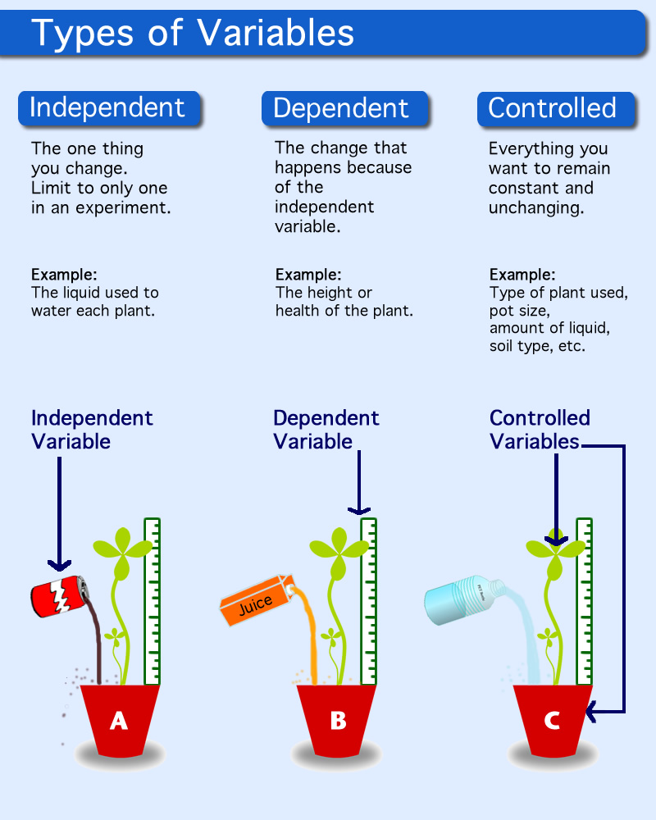

Slide 12
How to recognize variables in hypothesis:
Hypothesis is an: If, then statement
If I water the plant with different liquids, then it will affect the growth of the plant.
If portion of hypothesis = independent variable
Then portion of hypothesis = dependent variable
Independent variable
Dependent variable

Slide 13
Scientific Inquiry Vocab
Peer Review- peer’s review each others work to decide if it is valid or not.
Theory- an explanation for an observable event or fact for which no other explanation has been made.
Laws- generalizations about how the natural world behaves under certain conditions.
This means it can be explained (Theory means it should do something, law means it will)

