Slide 1
The Planets

Slide 2
Mercury
Closest planet to the sun.
Smallest planet in the solar system.
2nd hottest planet
Virtually no atmosphere, extremely thin due to constant solar bombardment.
Most cratered planet.
No moon
1 year on Mercury = 88 earth days
Terrestrial/Rocky

Slide 3
Venus
Earth’s “twin” or “sister planet” due to its size and mass.
Extremely thick atmosphere, which holds greenhouse gases, causing it to be the HOTTEST planet.
Atmosphere - Clouds of sulfuric acid
No moons
Rotates counterclockwise – retrograde.
Third brightest object in the sky.
Terrestrial/Rocky

Slide 4
Earth
Planet we live on.
Has liquid water and unique atmosphere containing oxygen to support life.
Has a magnetic field which helps deflect electromagnetic waves from the sun.
1 moon (The Moon/Luna)
MOST dense planet.
Terrestrial/Rocky

Slide 5
Mars
“Red Planet”
Named after the Roman god of war, due to its red color (from rust) Fe+O = rust
Atmosphere is mostly CO2 and very thin
Large dust storms
2 moons: Phobos, Deimos
Has the tallest known mountain in the solar system: Olympus Mons (shield volcano)
Terrestrial/Rocky

Slide 6
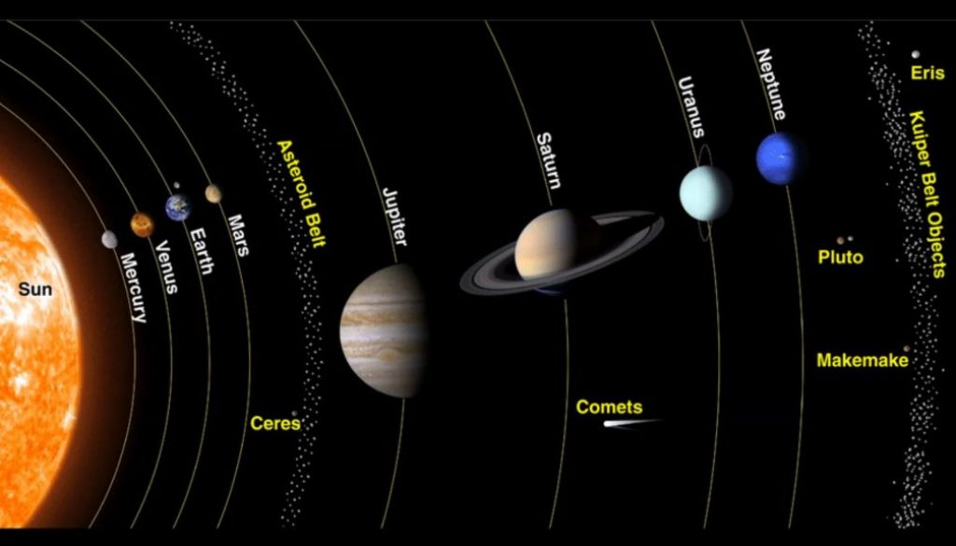
Asteroid Belt

Slide 7
Jupiter
Largest planet in the solar system
67 known moons: Io, Europa, Ganymede, & Callisto (largest/most studied)
4th brightest object (Sun, moon, and Venus are brighter)
Rotates in 10 hours (shortest rotation)
Takes 11.8 years to orbit the sun
“Great Red Spot” – huge storm on Jupiter that is 2 to 3 times larger than Earth.
Gas Giant

Slide 8
Saturn
Known for its many rings made of dust and ice.
LEAST DENSE Planet! Average density less than water.
62 known moons. Titan is the largest.
Made of mostly hydrogen
Takes 29.4 earth years to revolve around the sun.
Gas Giant

Slide 9
Uranus
Axis is sideways/horizontal and rotates north and south, tilted at 98 degrees.
27 known moons
Discovered via telescope by William Herschel in 1781
Takes 84 earth years to revolve around the sun.
Methane/methane ice crystals give the planet its blue color.
Voyager 2 (1986) only spacecraft to fly past.
Gas Giant

Slide 10
Neptune
Although smaller than Uranus, Neptune has a greater mass
14 known moons. Triton is the most famous.
Also has storms “Great Dark Spot” lasted 5 years.
Voyager 2 passed by Neptune as well.
Scientists found its location using math.
Gas Giant

Slide 11
Pluto
Discovered in 1930
Dwarf Planet
5 known moons: Charon most famous
1/3 of the planet is ice, 2/3 is rock
Pluto has an eccentric orbit and is sometimes closer to the sun than Neptune.
Revolves once every 248 earth years.
New Horizons spacecraft passed Pluto on July 14, 2015 on its way to the Kuiper Belt.

Slide 12
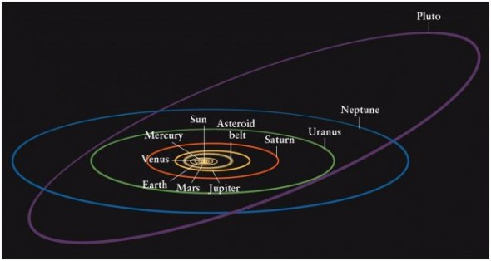
Orbits

