Slide 1
Stars Notes
Ch. 28

Slide 3
Light
Light refers to a form of radiation that stars and other celestial objects emit.
Light is a form of electromagnetic radiation, which is energy that travels in waves. (300,000 km per sec – speed of light)
*Electromagnetic waves can travel through empty space, unlike sound or water waves, which need a medium.*

Slide 4
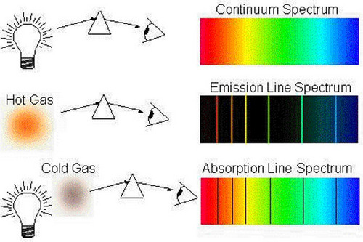
Spectroscope – device which uses a prism to split the light gathered by a telescope into a spectrum. Spectroscopes break light into three different spectra:
A stars absorption spectrum indicates the composition of the stars outer layer.

Slide 5
Continuous Spectrum
Unbroken band of colors, which shows that its source is emitting light of all visible wavelengths.

Slide 6
Emission Spectrum
Series of unevenly spaced lines of different colors and brightness. The bright lines show that the source is emitting light of only certain wavelengths.

Slide 7
Absorption Spectrum
Continuous spectrum crossed by dark lines. These lines form when light from a glowing object passes through a cooler gas, which absorbs some of the wavelength.

Slide 8
Each element absorbs and emits particular colors of visible light. By analyzing the spectrum of a star we can determine the elements the star is composed of.
Doppler Effect can be used to determine if a star is moving towards or away from the earth. Shorter wavelengths mean the star is approaching earth (blue shift), longer wavelengths mean the star is moving away (redshift).

Slide 9
Stars & Their Characteristics:

Slide 10
Constellations
human made groups of stars. These groups appear to be in different locations in the night sky as the earth rotates and revolves around the sun. Different constellations can be viewed during different seasons.

Slide 11
Apparent Magnitude
measure of how bright a star appears to be to an observer on Earth. The lower a stars magnitude number, the brighter the star is.

Slide 12
Astronomical Unit (AU)
express distances within the solar system. Average distance between the sun and the Earth.

Slide 13
Light-year
unit that measures the distance that a ray of light travels in one year. Light travels at 300,000 km per sec so in one year light travels about 9.5x10^12 kilometers.

Slide 14
Parallax
is a change in an object’s direction due to a change in the observer’s position.

Slide 15
Luminosity
actual brightness of a star. This depends on the size and temperature of the star.

Slide 16
Absolute magnitude
is a measure of how bright the star would be if all stars were at the same distance from earth.

Slide 17
The Life Cycle of Stars

Slide 18
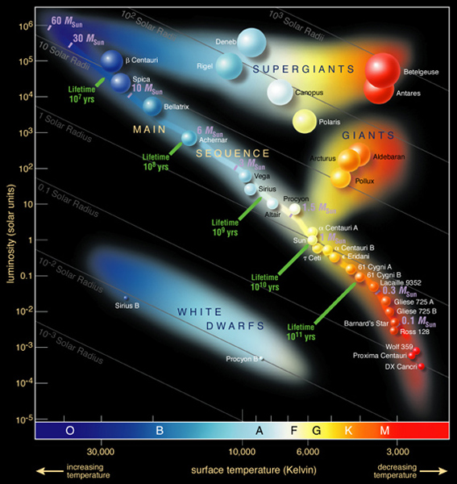
The Hertzsprung-Russell Diagram plots the luminosity of stars against their surface temperatures.

Slide 19
Red stars have lower temperatures.
Blue stars have highest temperatures.
Main Sequence Stars – 90% of stars fall in this category.
Giant stars have diameters from 10 to 100 times greater than that of the sun.
Supergiants are stars that have diameters 100 times greater than that of the sun.
White Dwarfs are stars that are near the end of their lives, were once red giants.

Slide 20
Life and death of a star

Slide 21
Star Life Cycle

Slide 22
Nebula
A cloud of gas and dust that gives birth to stars.

Slide 23
Protostar
Areas within a nebula where gas and dust have condensed enough to start growing.
The beginning of a star/birth of star
Where fusion begins.

Slide 24
Main Sequence Star
Where a star spend most of its life. The mass of the star determines the path the star will take.

Slide 25
Red Giant/Supergiant
Red Giant- a star with a diameter of 10 and 100 times that of the sun.
Red Supergiant – a star with diameter more than 100 times that of the sun.

Slide 26
Planetary Nebula
A resulting glowing halo of gases when only a white dwarf is left.

Slide 27
Supernova
Explosion of a MASSIVE star resulting in bursts of light.

Slide 28
White Dwarf
Average star as it nears the end of its life.

Slide 29
Black Hole
The final life stage of an extremely massive star.
Has a gravitational field so intense not even light can escape.

Slide 30
Neutron Star
The super dense remains (core) of a massive star after a supernova.
Core collapses with enough force to push all of its electrons into the nucleus. The star is essentially a core of neutrons.

Slide 31
Galaxies and the universe

Slide 32
Galaxy – systems containing millions or even billions of stars. Believed to be 50 to 100 billion galaxies in the universe. Our solar system lies in the MILKY WAY galaxy.

Slide 33
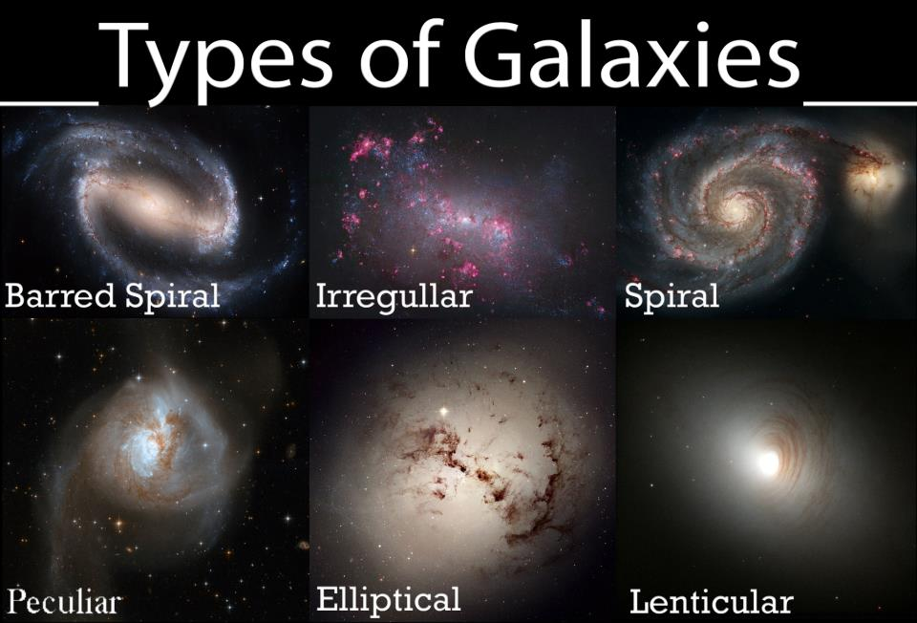

Slide 34
Origin of the Universe
Big Bang Model: 10-20 billion years ago all matter in the universe existed in an incredibly hot and dense state, from which it expanded and cooled, slowly condensing into stars and galaxies. Current evidence to support this model is that the distance between galaxies and groups of galaxies seems to have been increasing with time. The universe is currently expanding.

Slide 35
