Slide 1
Soil
Ch. 12

Slide 2
What is Soil?
Soil – relatively thin surface layer of the Earth’s crust consisting of mineral and organic matter that is affected by agents such as weather, wind, water, and organisms.

Slide 3
What is Soil Composed (Made) of?
Rock/Mineral particles (45%)
Organic matter (about 5%)
Water (about 25%)
Air (about 25%)

Slide 4
Why is Soil Important?
Organisms, mainly microorganisms, inhabit the soil and depend on it for shelter, food, and water.
Plants anchor themselves into the soil, and get their nutrients and water. Terrestrial plans could not survive without soil; therefore humans could not exist without soil either!

Slide 5
How Does Soil Form?
Soil forms from a “parent material”. This happens because rock is slowly broken down over time into smaller particles by biological, chemical, and mechanical (physical) weathering.

Slide 6
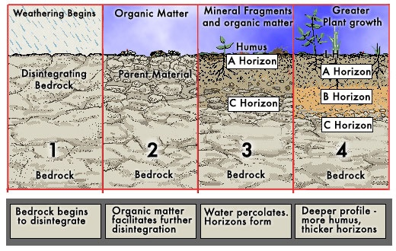

Slide 7
How can we conserve our Soil?
Soil is naturally eroded by weather (wind and water) but we can reduce the human activity that accelerates soil erosion. We can do this by implementing soil erosion conservation methods:

Slide 8
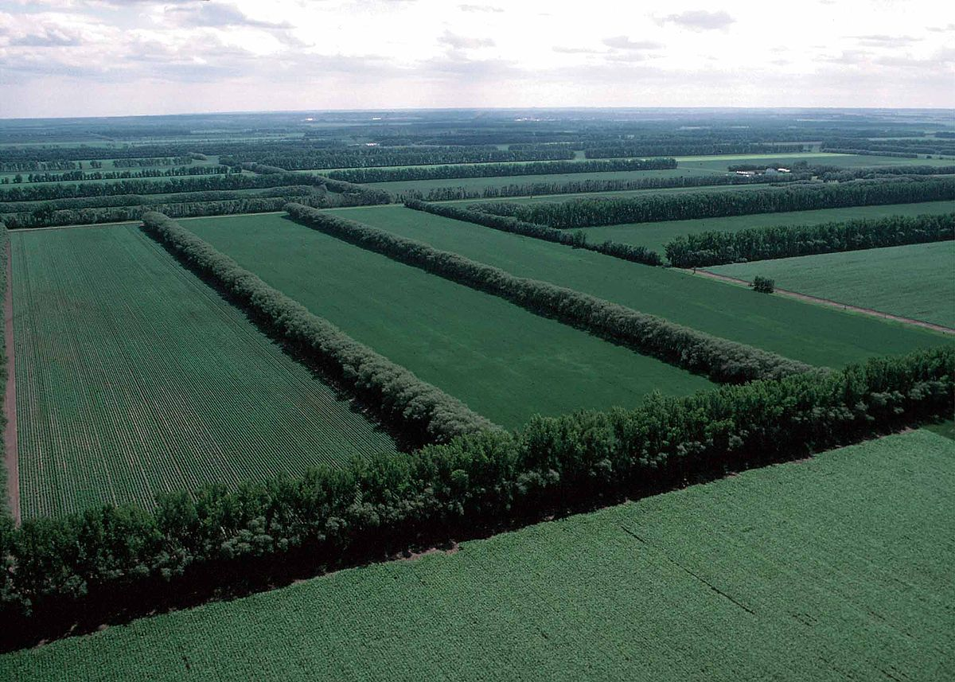
Planting windbreaks – aka shelterbelts are belts of trees planted along the edges of field to slow the wind and water erosion

Slide 9
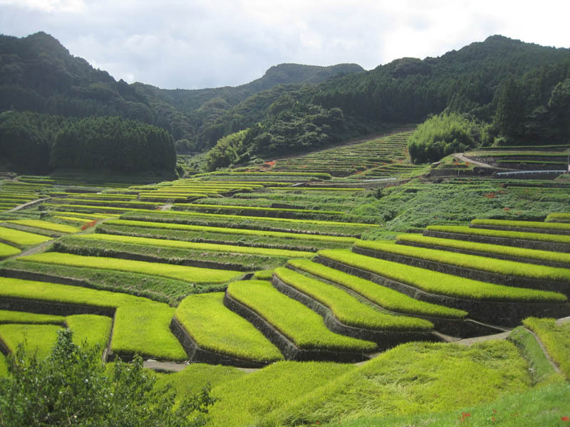
Constructing terraces – farmers flatten the slope of the land into terraces (level flat areas resembling steps) which slows the speed of runoff.

Slide 10
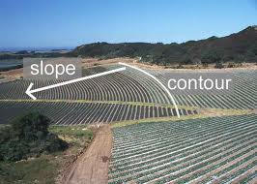
Contour farming – is a method that prevents water from flowing rapidly downhill and carrying soil with it. Farmers plant crops in rows parallel to land contours.

Slide 11
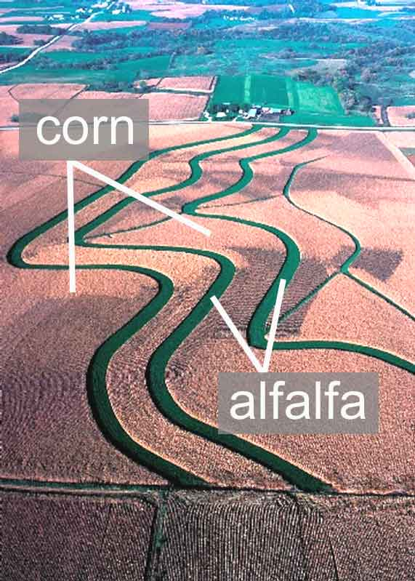
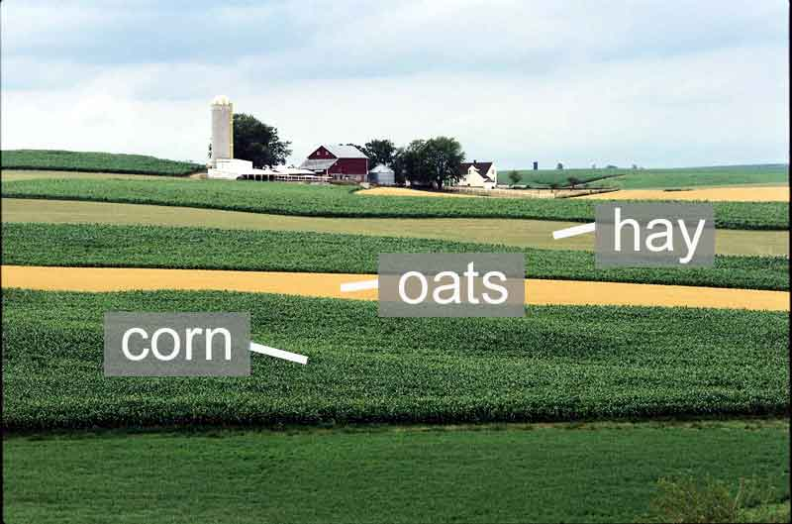
Strip-cropping – farmers alternate a crop that leaves bare ground between rows with a crop that completely covers the ground. (Ex: planting alfalfa between rows of corn)

Slide 12
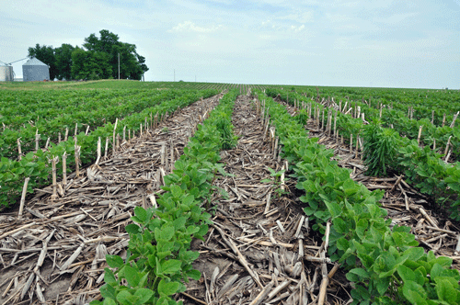
No till – plowing, planting, fertilizing, and weed control are all done at the same time. Once a crop is planted the ground is not disturbed until harvest.

Slide 13
SOIL PROFILE
Soil Profile – all of the different layers of soil combined together in a cross section.
Soil Horizon – individual layer of soil that differs in color and texture from the layers above or below it.

Slide 14
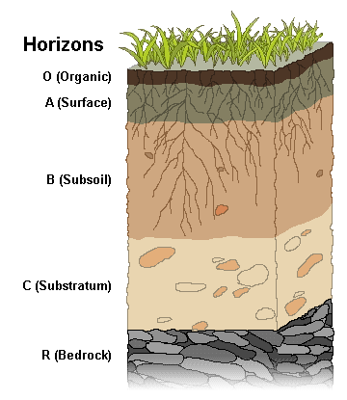
D

