Slide 1
Mountain Building
Ch. 11

Slide 2
Where Mountains Form:
Mountain – is a large mass of rock that rises a great distance above its base.
Mountains tend to occur in long belts that tend to follow CONVERGENT PLATE boundaries. These regions are where mountains form or have formed in the past.

Slide 3
How mountains form:
Stress – the measure of the amount of force applied over a given area.
Rocks that are on the surface of the earth tend to respond to stress by FAULTING/FRACTURING due to being rigid.

Slide 4
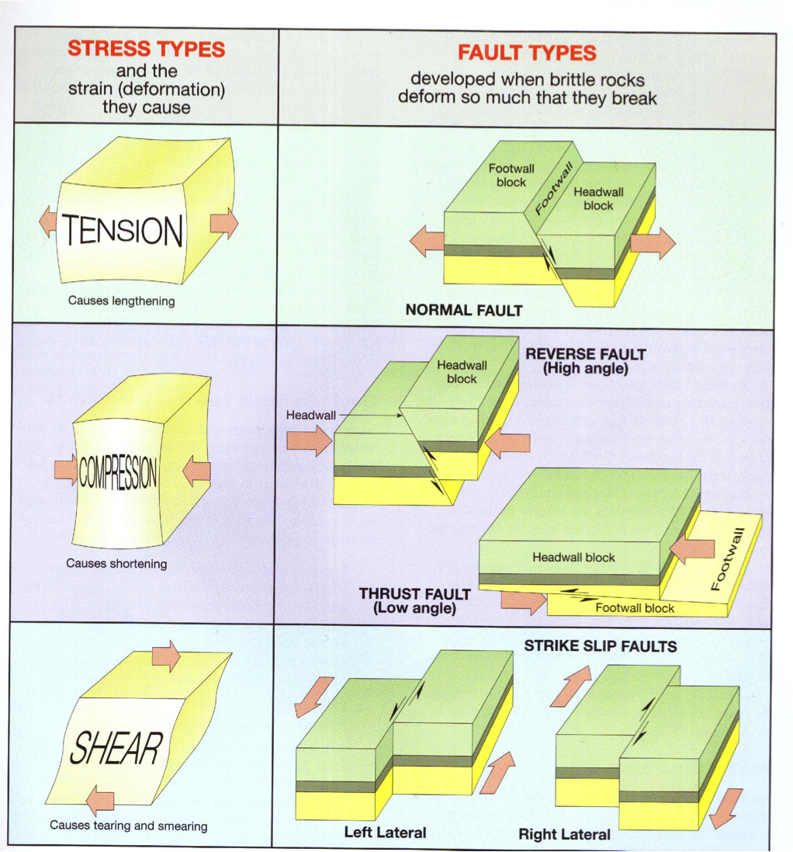
Divergent
Convergent
Transform

Slide 5
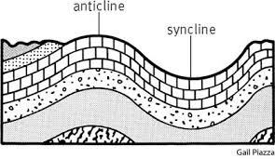
Rocks that are DEEPER in the earth may FOLD or STRETCH due to higher temperatures causing the rock to be less rigid.

Slide 6
FOLDED MOUNTAINS
Mountains formed when two plates carrying continental crust collide; folding the rocks and earth with great force.
Examples:
Appalachians
Alps
Urals
Northern Rocky Mts.
Himalaya Mts.

Slide 7
DOME MOUNTAINS
Is a nearly circular folded mountain. Individual isolated structures formed by uplift.
Examples:
Colorado Plateau
Parts of Rocky Mts.
Adirondack Mts. In NY
Black Hills of South Dakota

Slide 8
FAULT-BLOCK MOUNTAINS
Mountains formed from blocks of crust that have been faulted and tilted at the same time.
Examples:
Sierra Nevadas of California
Wasatch Range of Utah
Teton Range of Wyoming

Slide 9
VOLCANIC MOUNTAINS
Mountains formed from volcanic eruptions, usually on continental crust near a subduction boundary.
Examples:
Andes Mountains
Cascade Mountains

