Slide 1
Maps

Slide 2
Maps
Are pictures or representations of the Earth's surface.
They show how places are related to each other by distance, direction, and size.
Maps are a way of showing a part of the Earth's surface on a flat piece of paper.

Slide 3
Cartographers
People who make maps.
Cartography – study of maps

Slide 4
Features of Maps
Maps include the following:

Slide 5
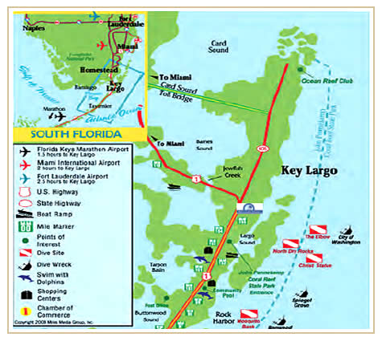
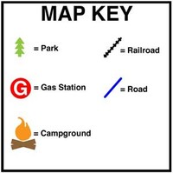
Key/Legend
A small box that lists symbols and tells what they represent.

Slide 6
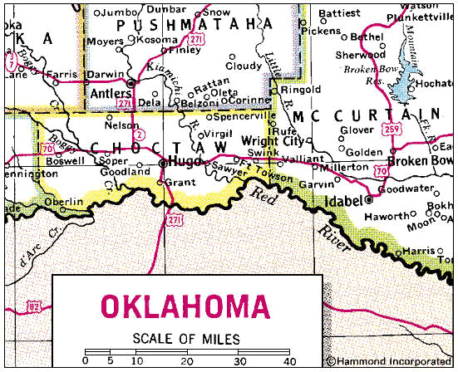
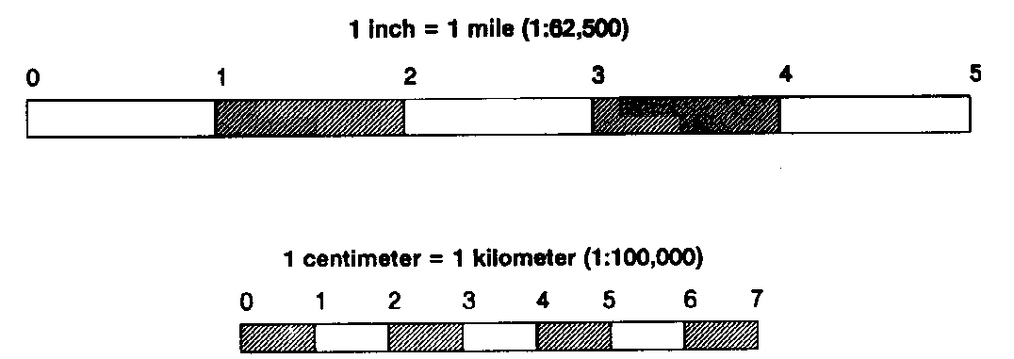
Scale
Line(s) that represent a direct connection between a unit of measurement on the map and the actual distance.

Slide 7
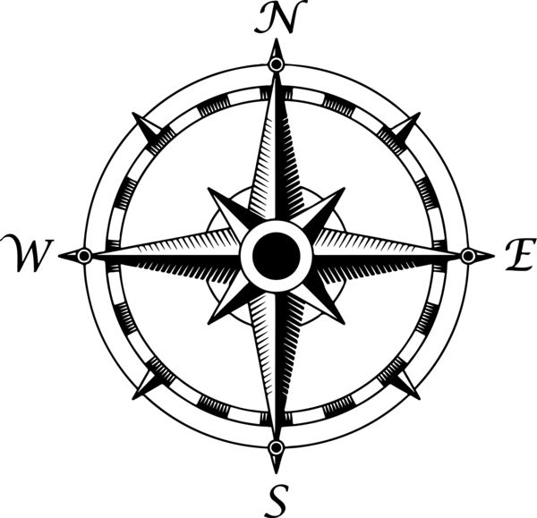
Compass/Compass Rose
Tool on the map that allows the user identify the four cardinal directions.

Slide 8
Latitude/Longitude
Imaginary grid on a map or globe.
Set of coordinates.
LATITUDE, LONGITUDE
Just like every actual house has its address (which includes the number, the name of the street, city, etc), every single point on the surface of earth can be specified by the latitude and longitude coordinates.

Slide 9
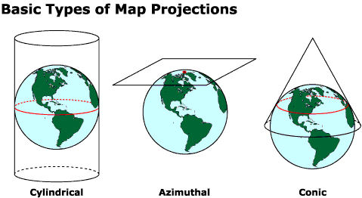

Slide 10
Map Projections
Map projections are used to represent the surface area of a solid object or a 3D object, and these map projections are used to create maps on a 2D surface.
ALL MAPS ARE DISTORTED IN SOME WAY. Because you can not perfectly map a spherical object on flat paper without distortion.

Slide 11
3 Types of Projections

Slide 12
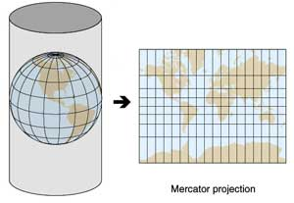
Mercator
Shows the whole world on a continuous map.
Shows directions as straight lines.
Distorts the map towards the poles.
Useful in navigation.

Slide 13
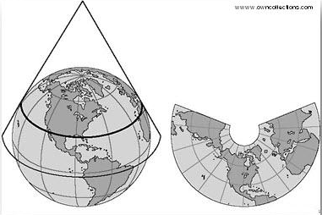
Polyconic
Less latitude distortion.
Lines of latitude are curved, but lines of longitude are straight.

Slide 14
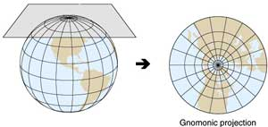
Gnomonic
Will show you the shortest distance between two points.
More distortion the farther you move away from center point.

Slide 15
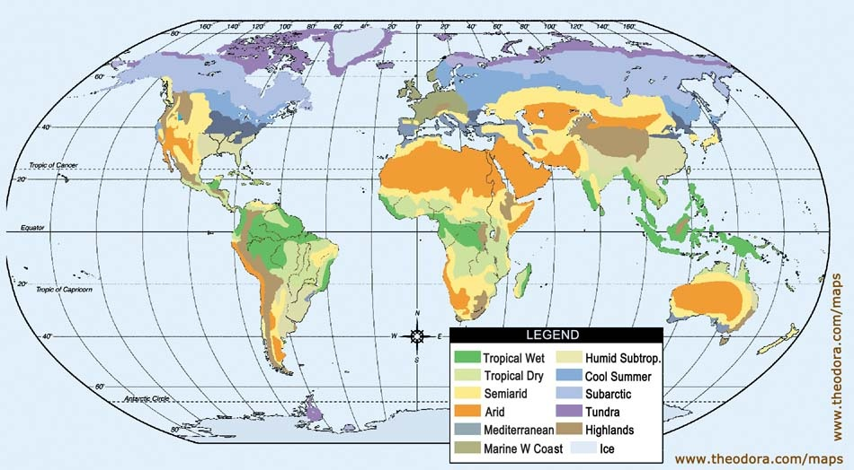
Climate Maps

Slide 16
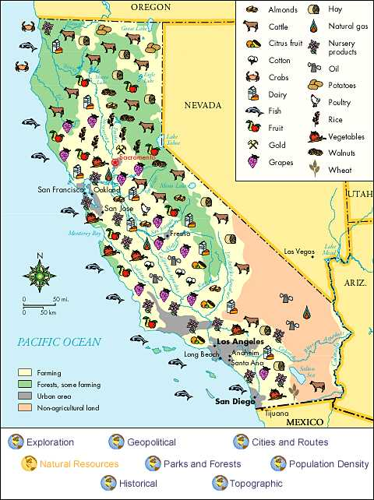
Economic/Resource Map

Slide 17
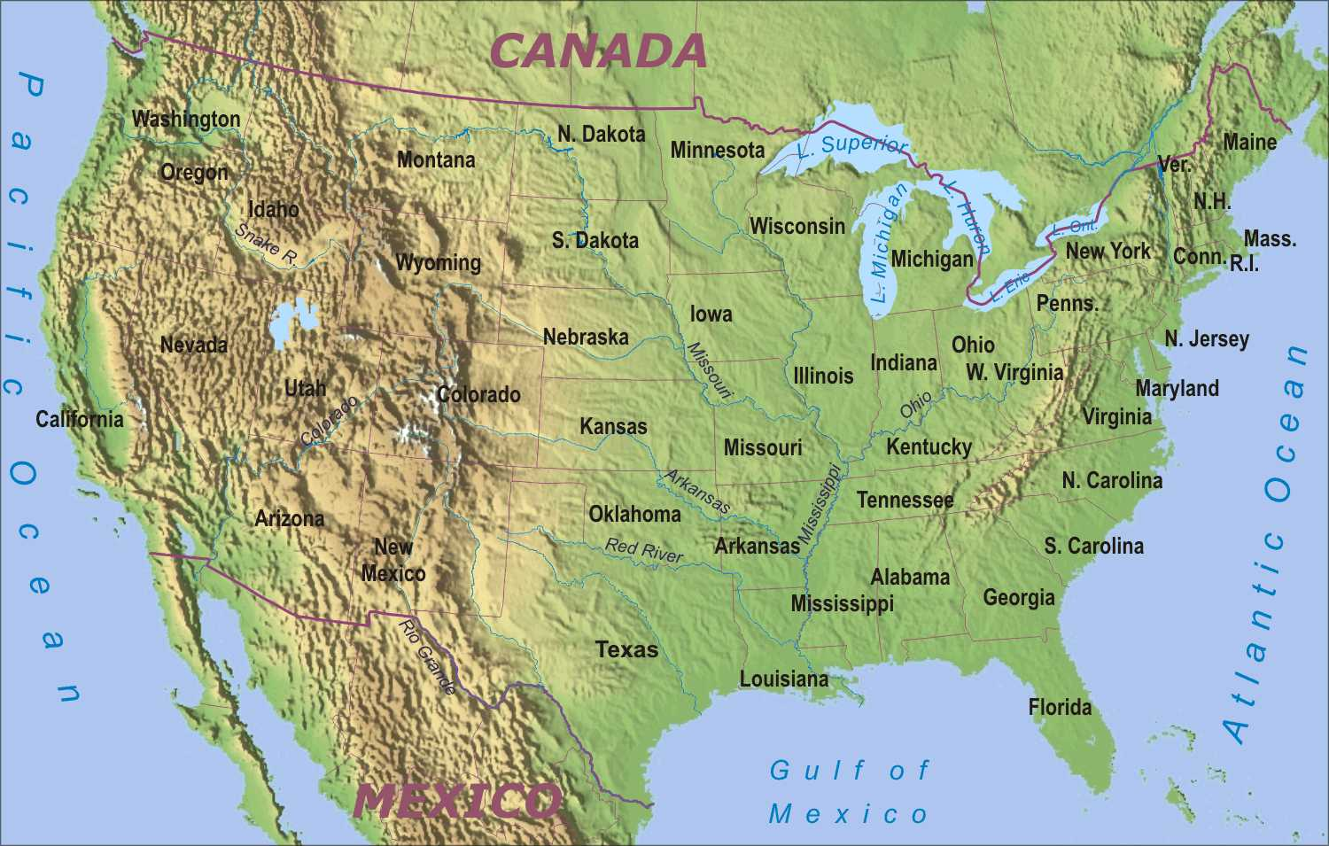
Physical Map

Slide 18
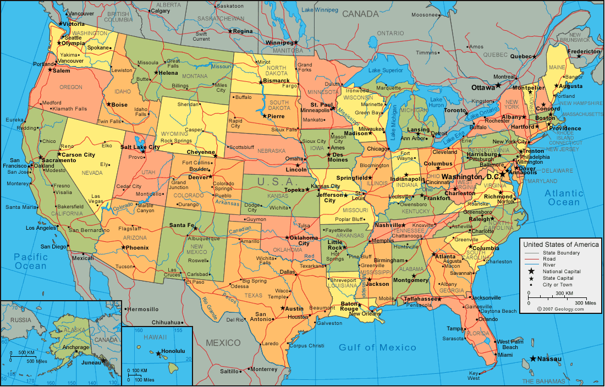
Political Map

Slide 19
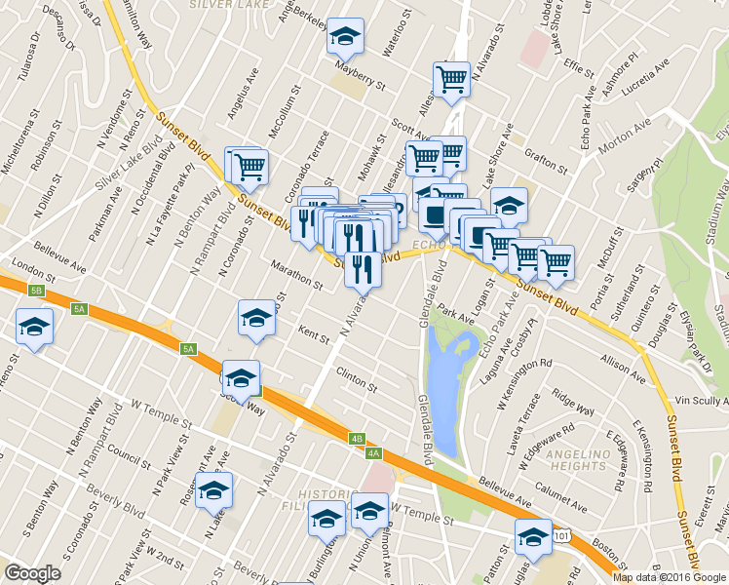
Street Maps

Slide 20
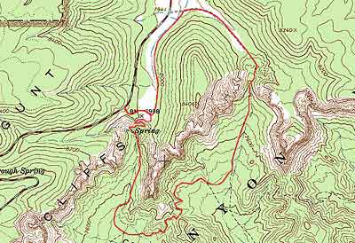
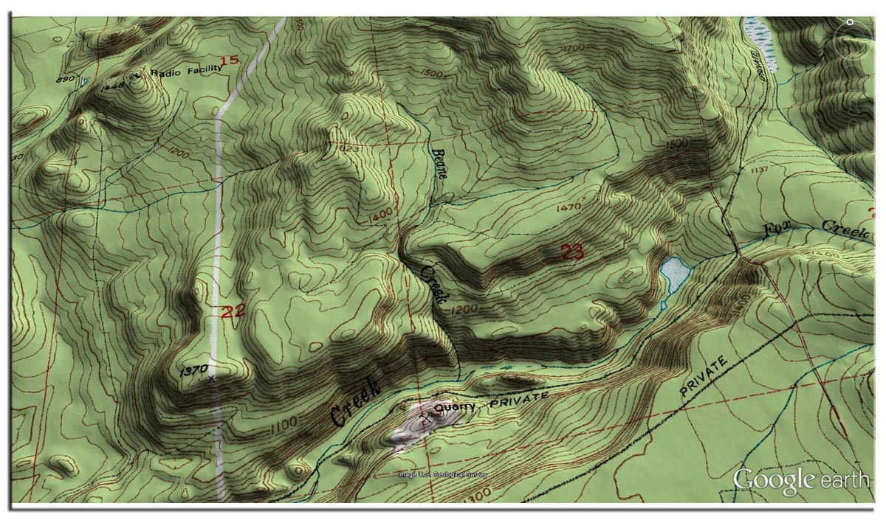
Topographic Maps

