Slide 1
History of Space Exploration
Timeline

Slide 2
1955-1960
1957 – Soviets launch SPUTNIK into orbit
First manmade satellite to orbit earth.
1958 – NASA is formed
1958 – Explorer 1 America’s 1st satellite is launched.
1960 – Yuri Gargarin (Soviet) first man in space aboard VOSTOK 1

Slide 3
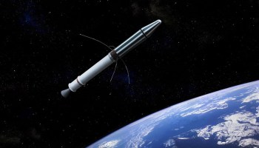
Sputnik
Explorer 1

Slide 4
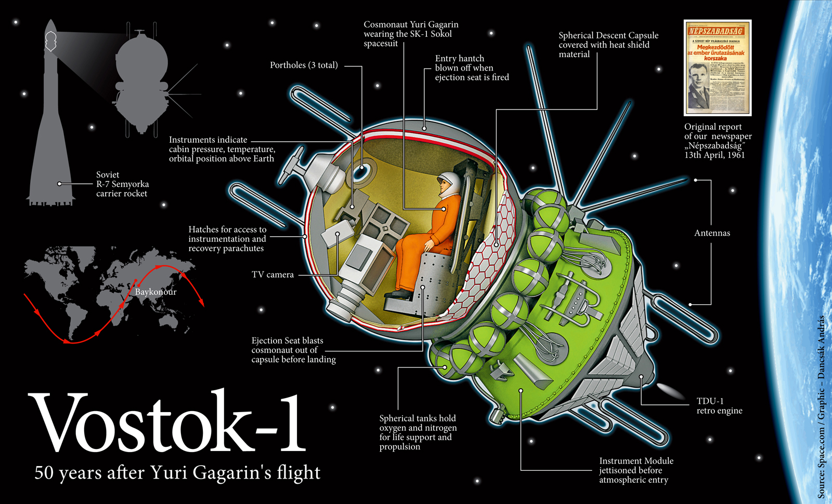

Slide 5
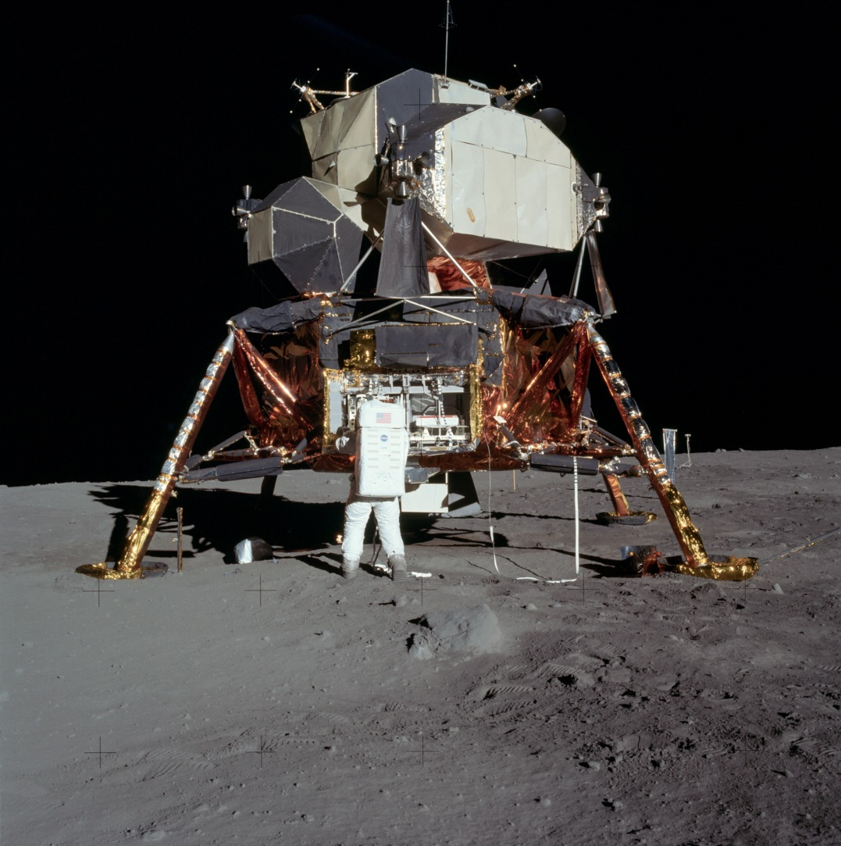
1965-1970
1969 – Neil Armstrong and Buzz Alderin are first men to land on the moon
Apollo 11 mission on the Eagle

Slide 6
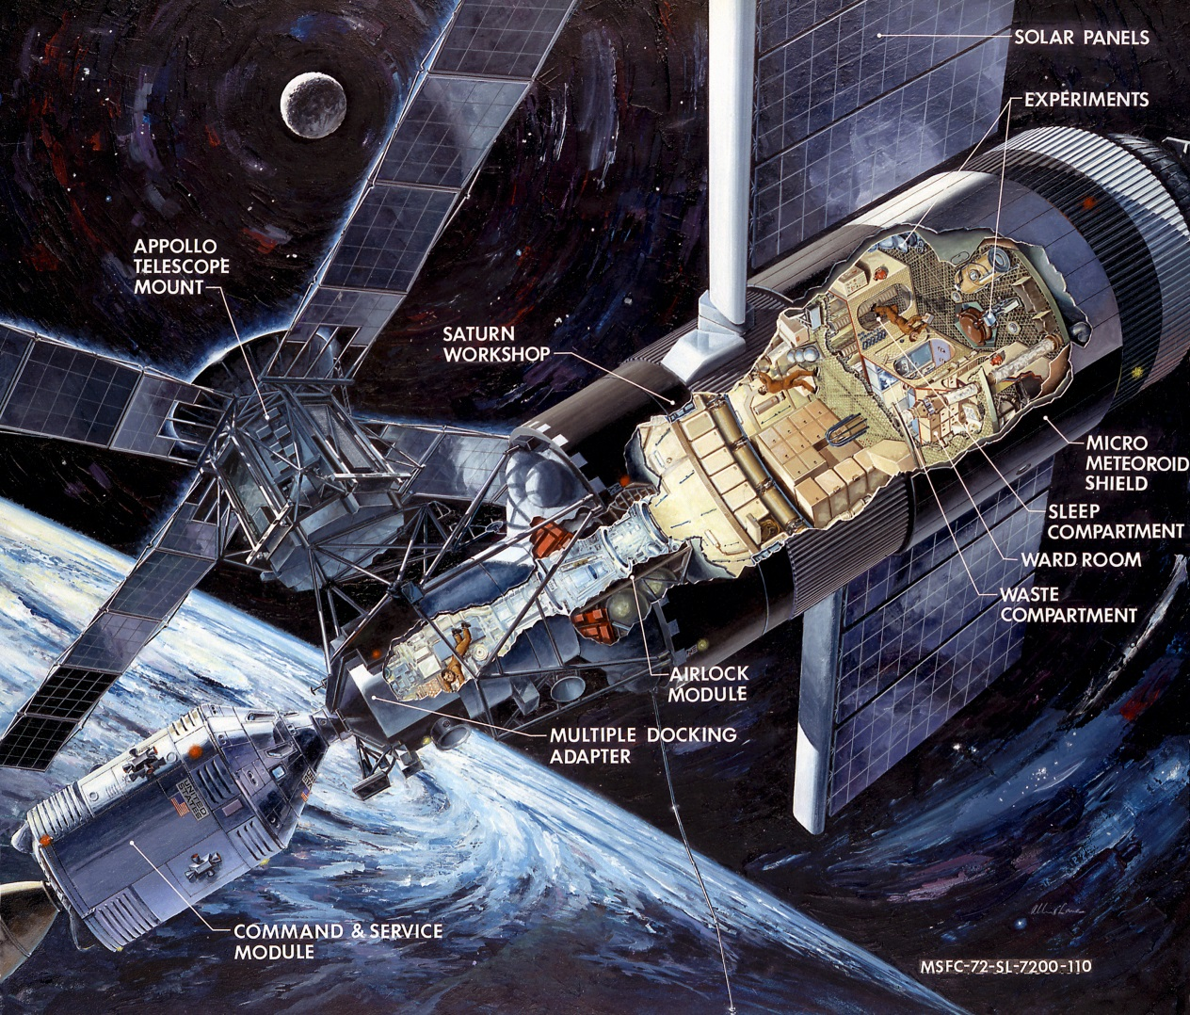
1970-1975
1973 – US Skylab space station was launched.

Slide 7
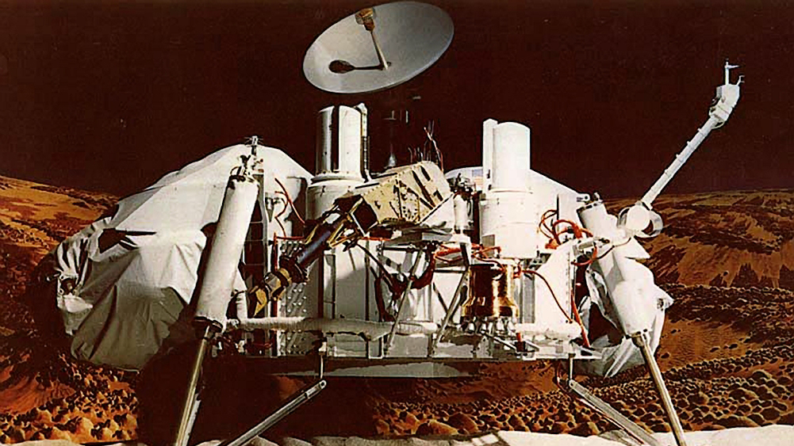
1975-1980
1976 – unmanned Viking 1 first spacecraft to land on Mars.

Slide 8
1980-1985
1981 – Columbia 1st reusable space shuttle launched.
1983 – Sally Ride first American woman in space.

Slide 9
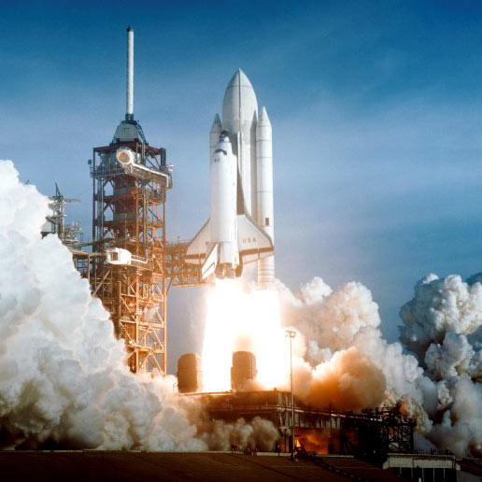
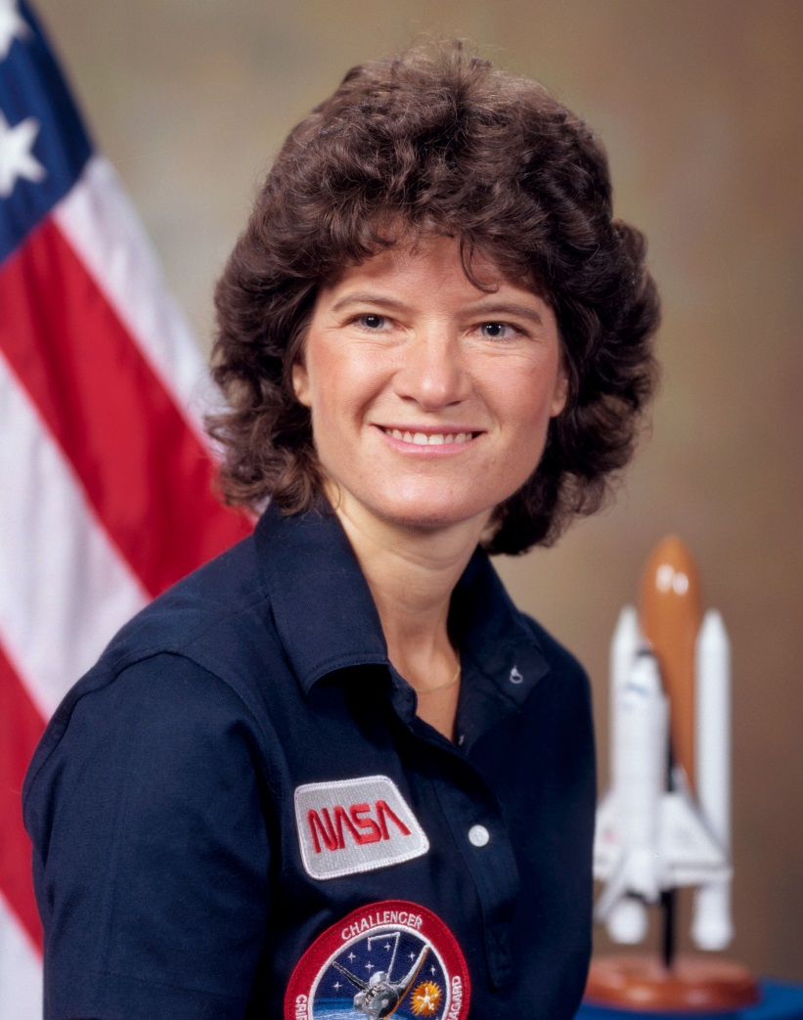
Columbia
Sally Ride

Slide 10
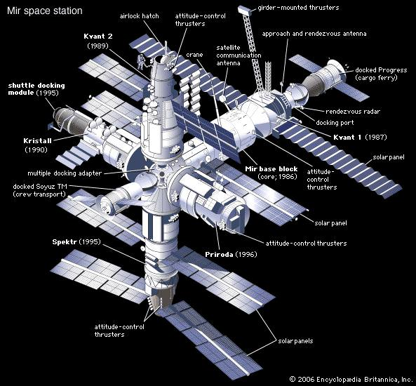
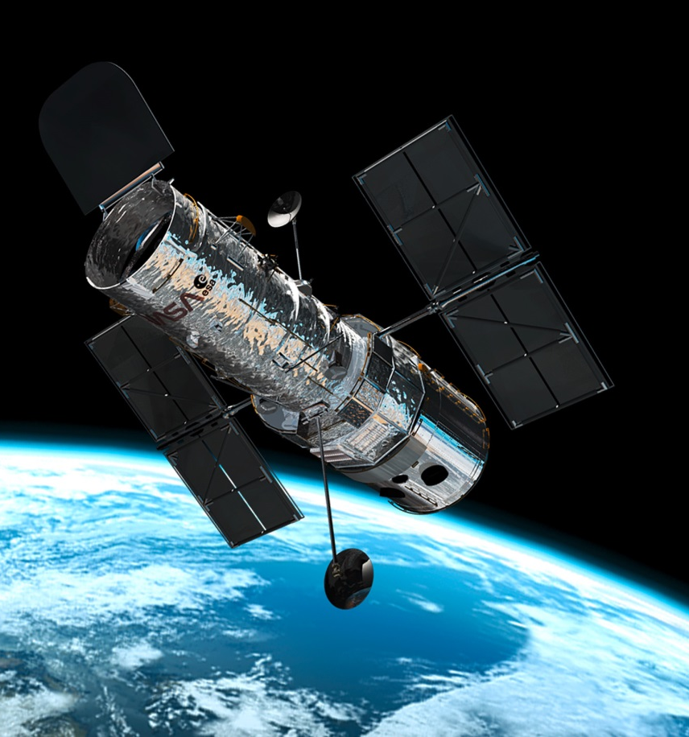
1985-1990
1986 – Mir space station launched.
1990 – Hubble space telescope launched.

Slide 11
2000-2005
2000 – International Space Station receives its first crew.
2001 – Mars Odyssey reaches Mars.
2003 – Columbia space shuttle disaster.
2004 – Cassini probe arrives at Saturn.
2004 – Spirit Rover lands on Mars.

Slide 12
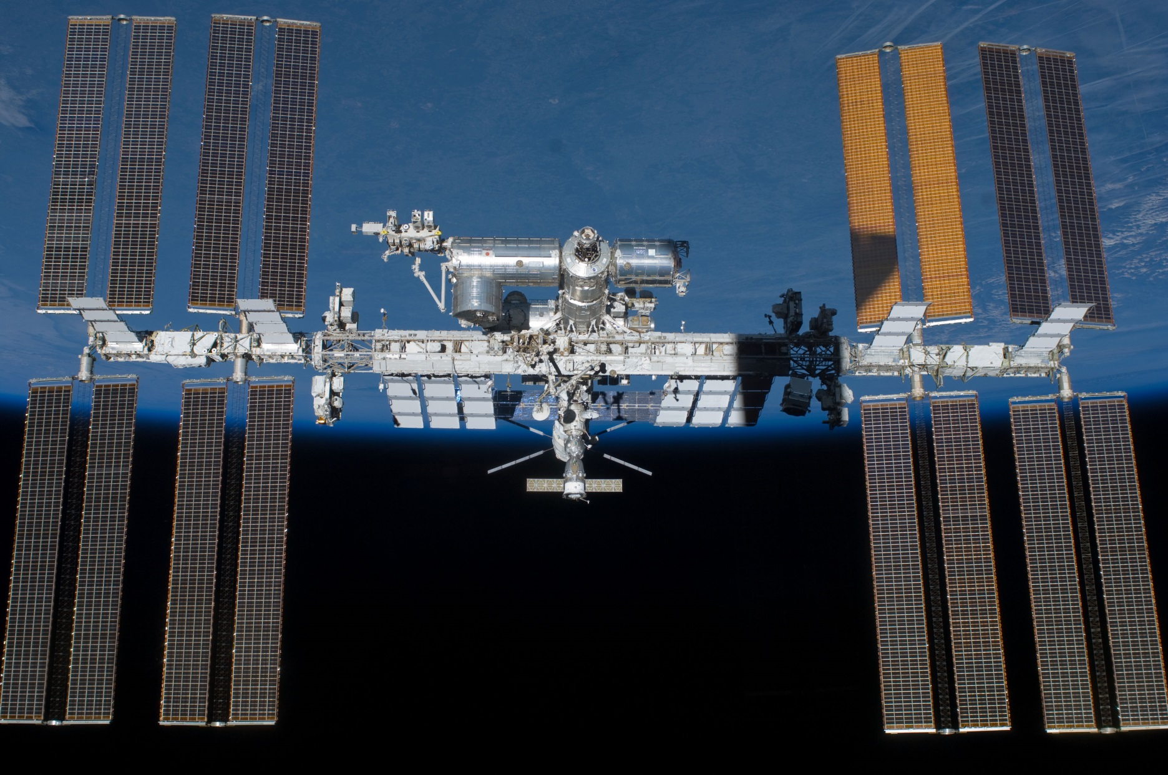
International Space Station

Slide 13
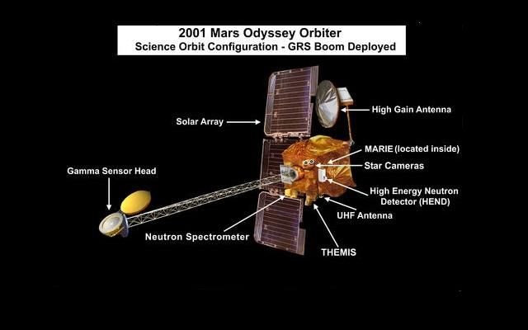

Slide 14
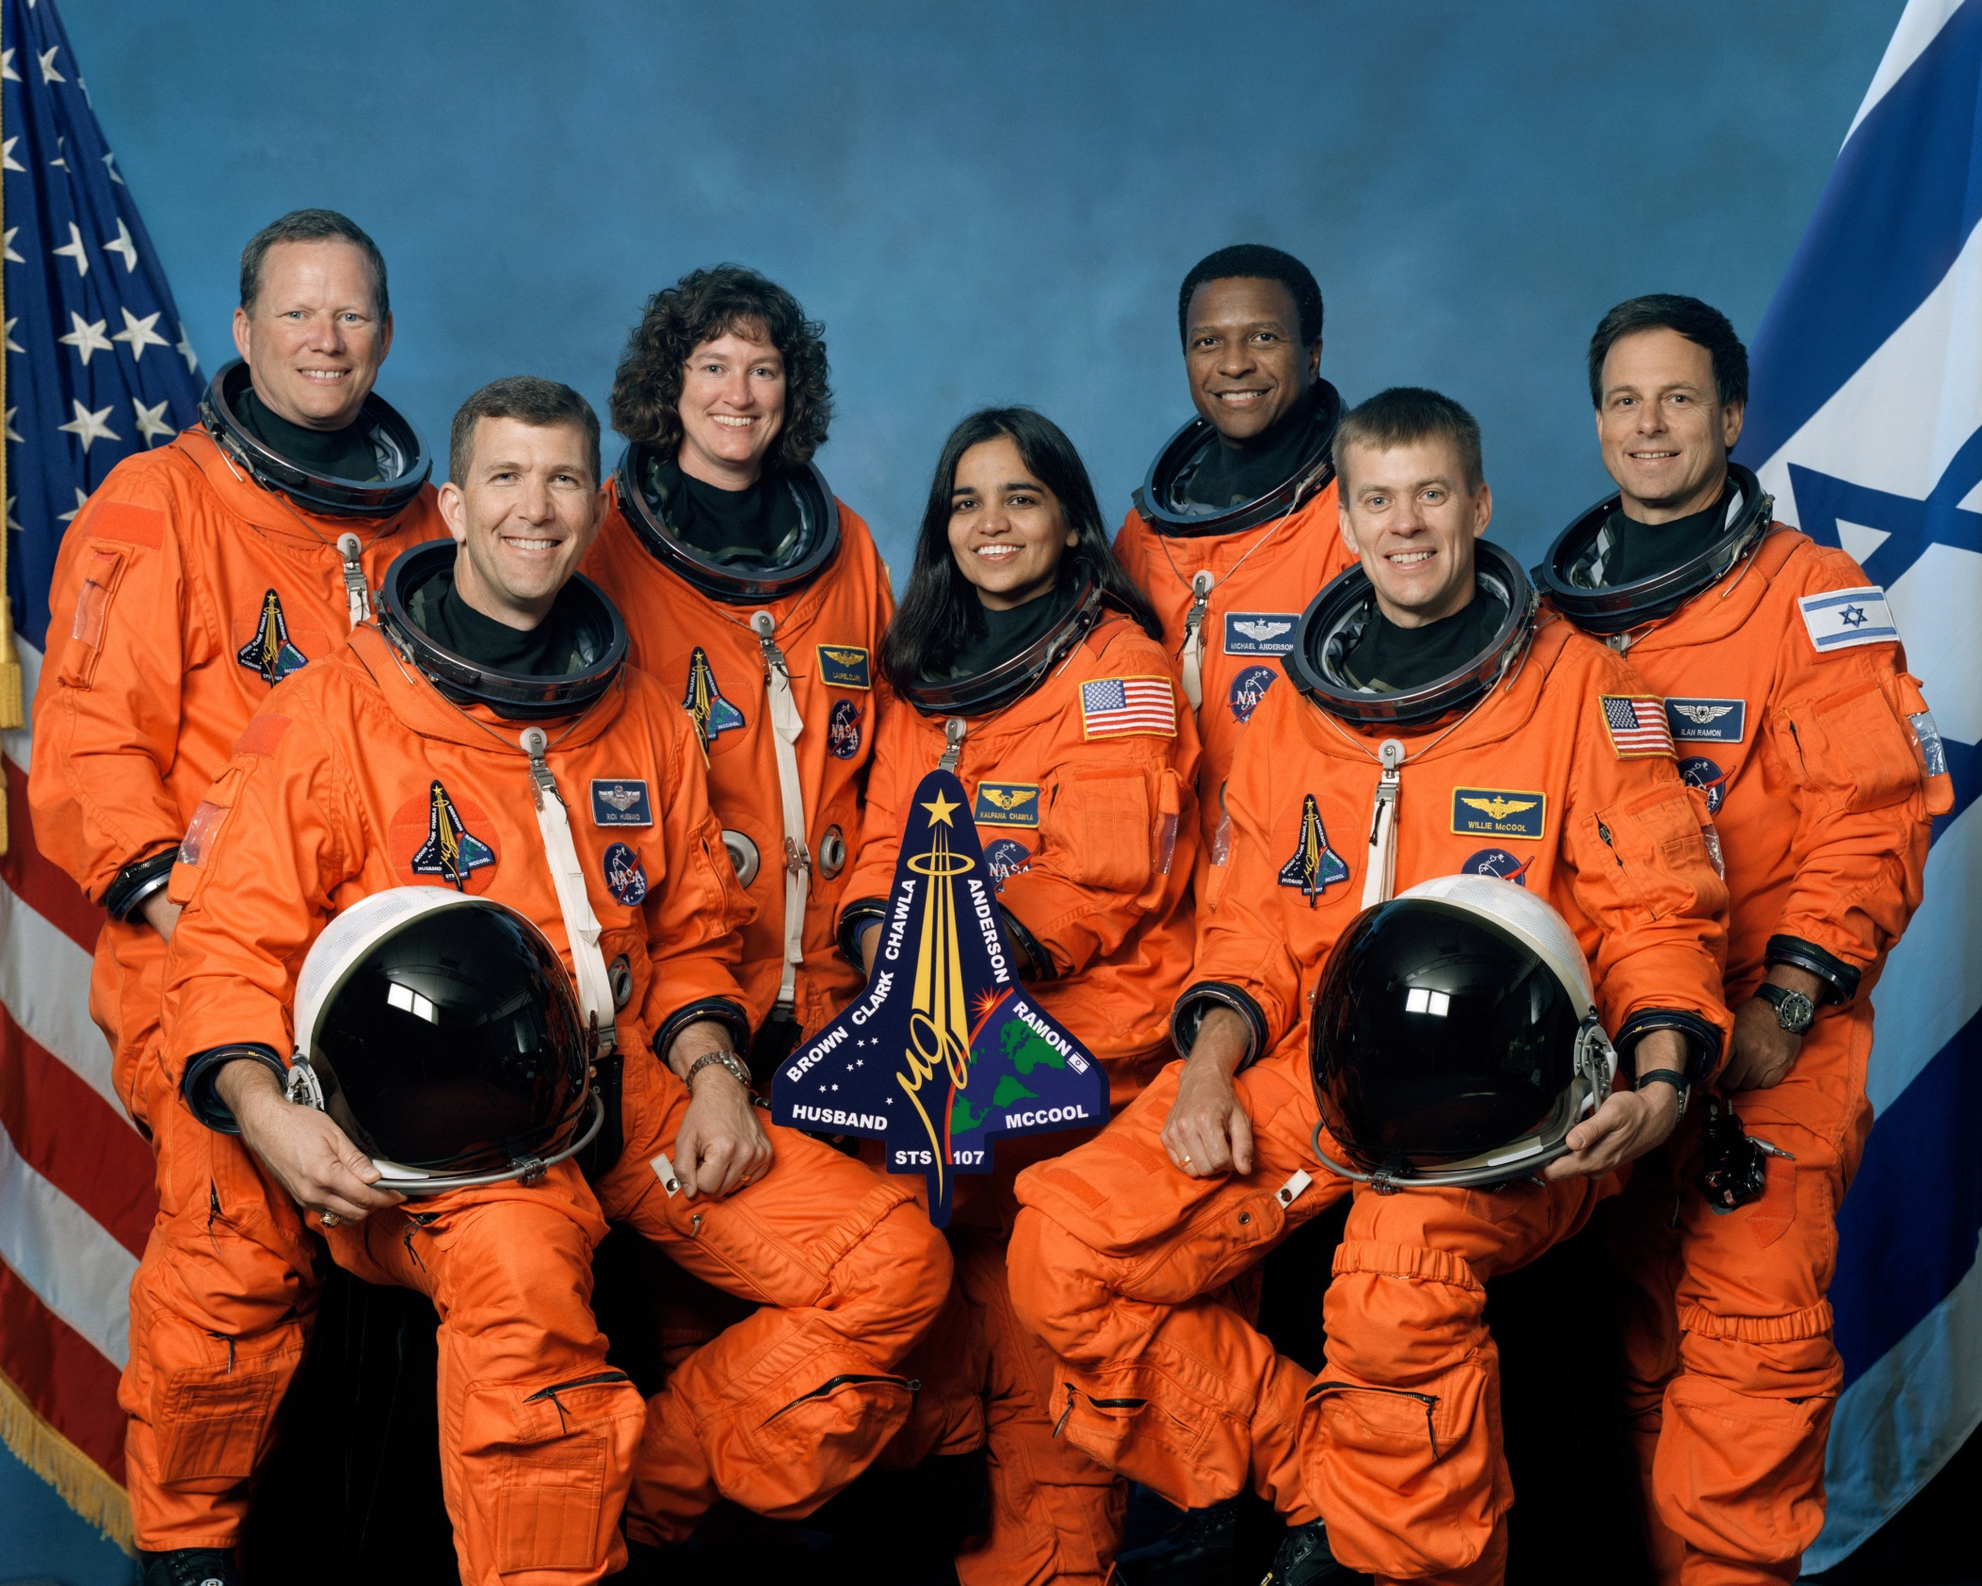

Slide 15
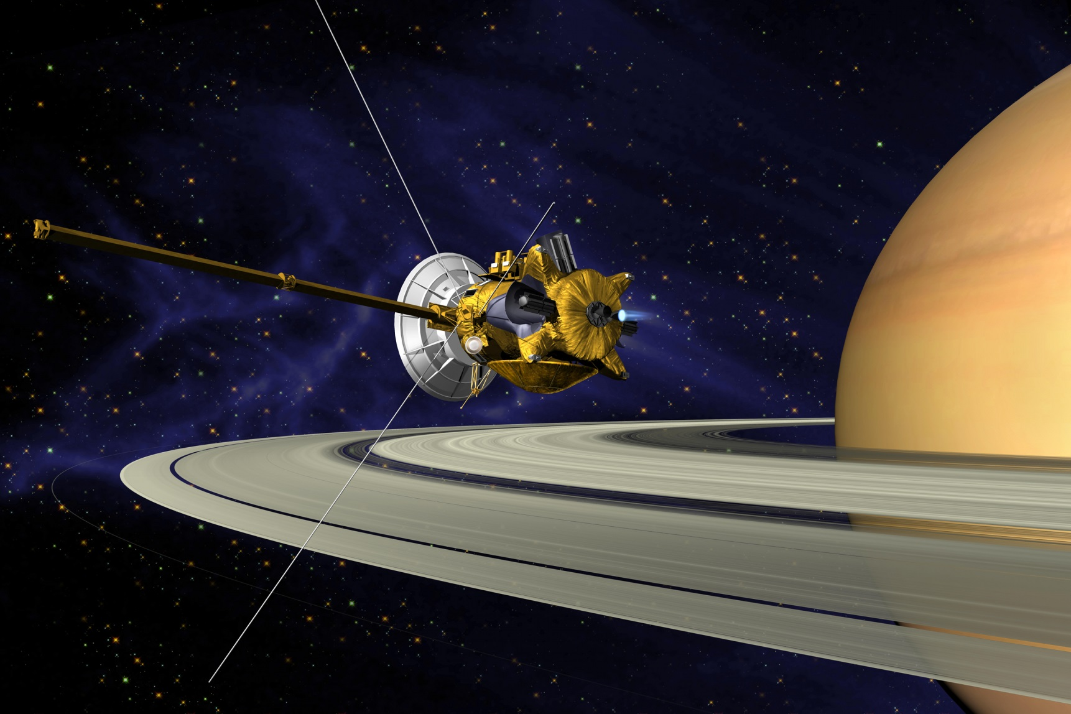
Cassini Space Probe

Slide 16
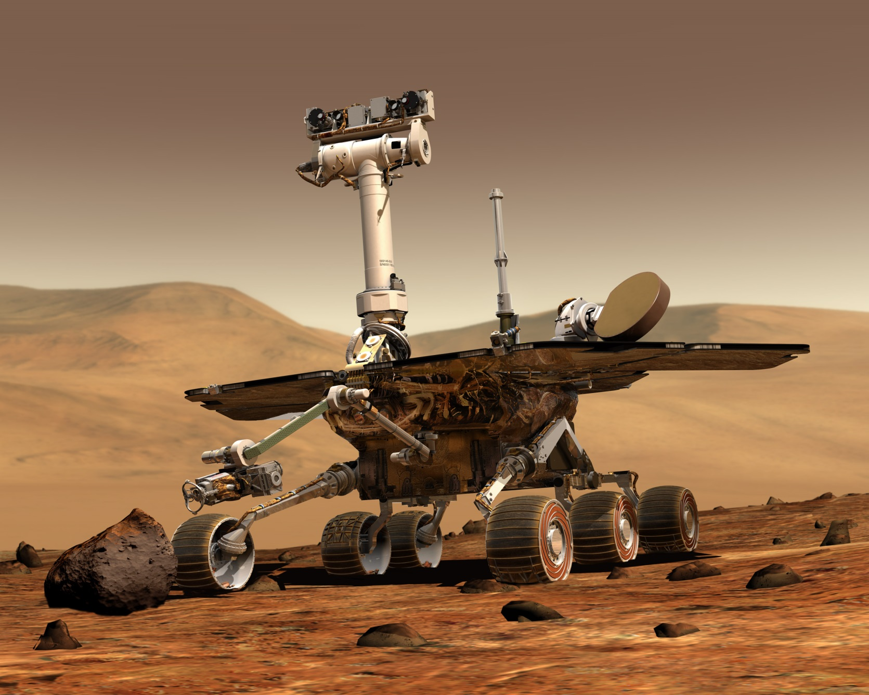
Spirit Rover

Slide 17
2010-2015
2011 – Final flight of space shuttle program to ISS (International Space Station)
2011 – Dawn Spacecraft orbits an asteroid
2012 – Curiosity rover lands on Mars.
2015 – New Horizons arrives at Pluto.

Slide 18
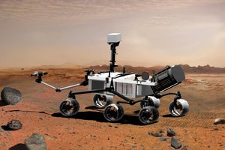
Curiosity Rover

Slide 19
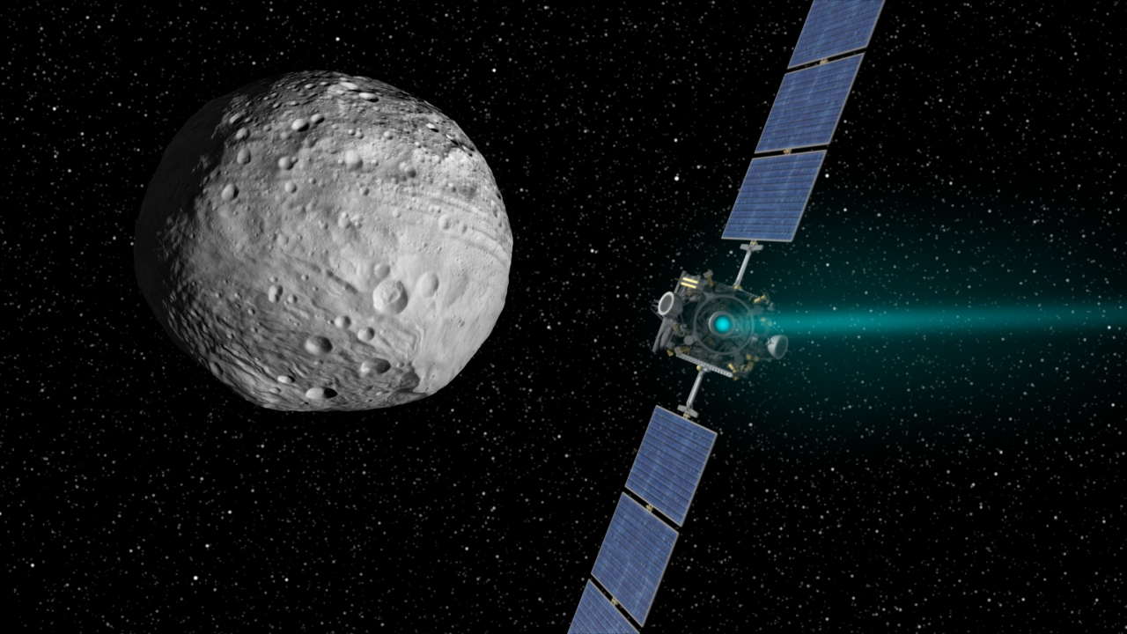
Dawn Spacecraft

Slide 20
