Slide 1
Geologic Time
Ch. 30

Slide 2
Geologic History
Determined by major characteristics in the Earth’s surface, climate, and types of organisms.

Slide 3
Geologic Time Scale
Summary of the major events in Earth’s past that are preserved in the fossil record.
Index Fossils - a fossil that is useful for dating and correlating the strata in which it is found. This is used in RELATIVE DATING.

Slide 4
Geologic Time Scale
By studying fossil record/index fossils, scientists have come up with the Theory of Evolution which states that there is a gradual change in living things over long periods of time.

Slide 5
Geologic Time Scale
The geologic time scale is broken down into larger and smaller “chunks” of time:
Eons
Eras
Periods
Epochs

Slide 6
Eon:
Largest/longest segment of geologic time.

Slide 7
Era:
A unit of geologic time that contains two or more periods

Slide 8
Period:
A unit of geologic time that is longer than an epoch, but shorter than an era.

Slide 9
Epoch:
A unit of geologic time that is longer than an age but shorter than a period

Slide 10
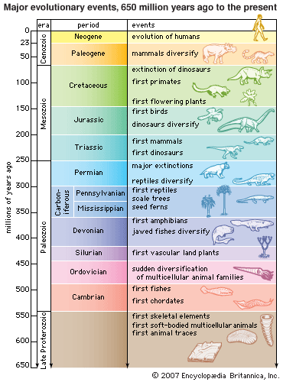

Slide 11
Precambrian Era:
4.6 Billion to 542 Million Years Ago
88% of the Earth’s History
Divided into three eras: the Hadean, the Archean and the Proterozoic.
Very little is known because rock layers have been eroded and deformed by plate tectonics
Period during which the atmosphere developed oxygen and as a result life originated.
Single celled organisms - bacteria

Slide 12
Paleozoic Era:
542 to 251 Million Years Ago (mya)
Includes six periods: Cambrian, Ordovician, Silurian, Devonian, Carboniferous (Mississippian &Pennsylvanian Periods), and Permian.
Cambrian Explosion: “Explosion” of diversity that occurred very rapidly in the fossil record.
Continents went from separate to Pangaea during this time period.
Far richer in plant and animal life
Vertebrates such as fish, reptiles, and amphibians developed.
90% of marine and 70% of land life died at end of era.

Slide 13
Mesozoic Era:
251 to 65.5 million years ago
Divided into three periods: Triassic, Jurassic, and Cretaceous.
Continents begin to drift apart.
“Age of Reptiles”, including dinosaurs (HUMANS AND DINOSAURS DID NOT LIVE AT THE SAME TIME!!)
Mass extinction at end, possibly by an asteroid impact about 65 million years ago.
Flowering plants begin to develop.

Slide 14
Cenozoic Era:
65.5 million years ago to Present
Divided into three periods: the Paleogene, Neogene, and Quarternary.
Warm and humid climate.
Temperatures decreased.
“Age of Mammals”
Fossils of first humanoids began to develop.

Slide 15
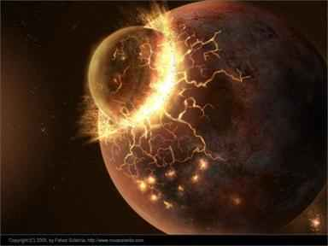
Age of the Earth
4.6 Billion Years Old

Slide 16
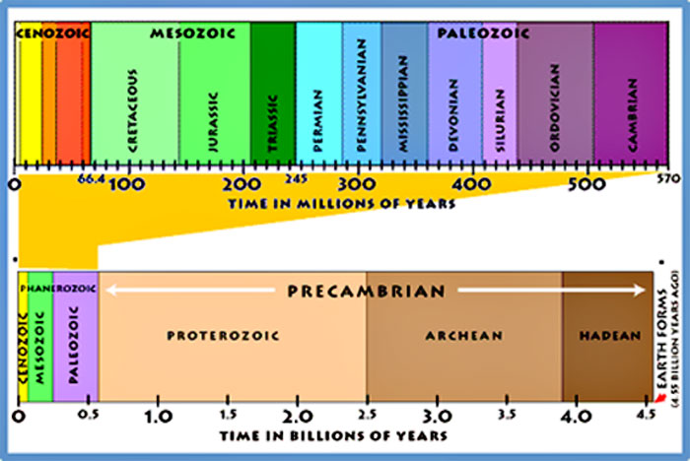
Eras & Periods

Slide 17
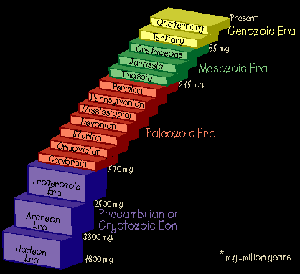
Eras & Periods

