Slide 1
Earthquakes
Ch. 10

Slide 2
Parts of an earthquake:

Slide 3
Types of Seismic Waves
PRIMARY WAVES – arrive first, can travel through any material.

Slide 4
Types of Seismic Waves
SECONDARY WAVES – arrive second, can travel through solids.

Slide 5
Types of Seismic Waves
SURFACE WAVES
L WAVES RAYLEIGH WAVES

Slide 6
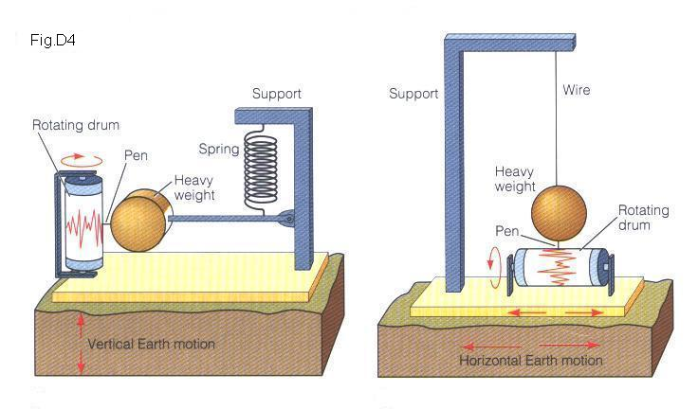
Seismograph:
Instrument that detects and records waves produced by earthquakes.

Slide 7
Seismogram:

