Slide 1
Rock Examples

Slide 3
Igneous Rocks

Slide 4
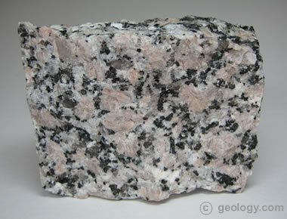
1. Granite

Slide 5
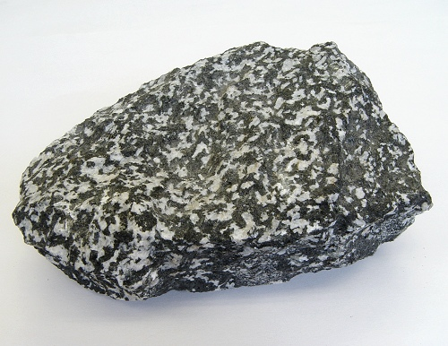
2. Diorite

Slide 6
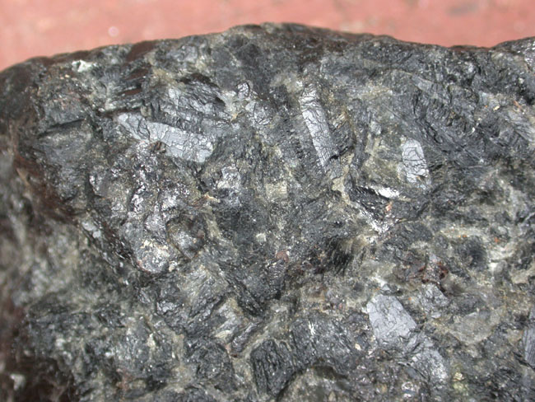
3. Gabbro

Slide 7
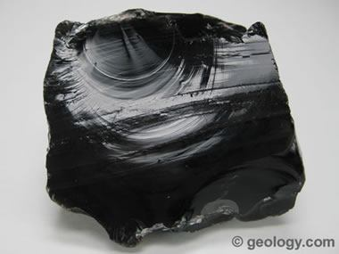
4. Obsidian

Slide 8
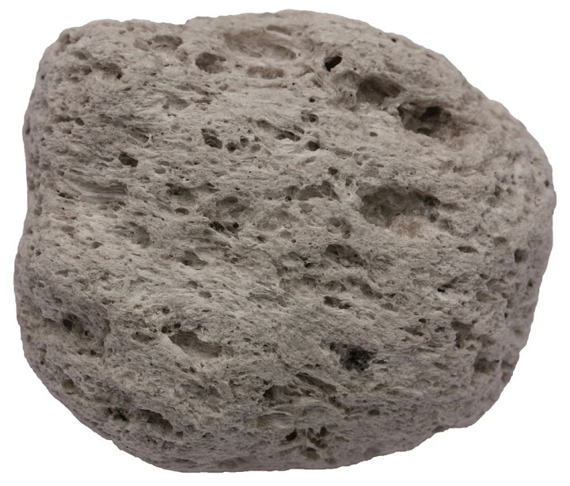
5. Pumice

Slide 9
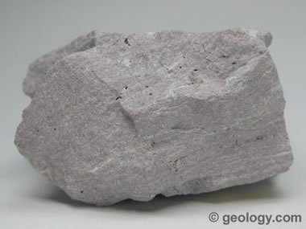
6. Rhyolite

Slide 10
7. Basalt

Slide 11
Sedimentary Rocks

Slide 12
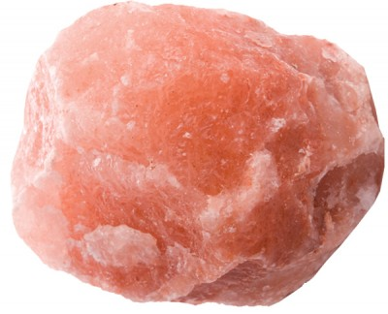
8. Rock Salt

Slide 13
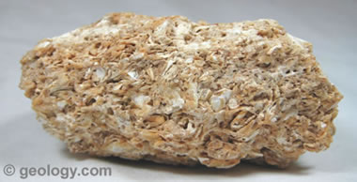
9. Coquina

Slide 14
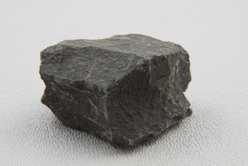
10. Shale

Slide 15
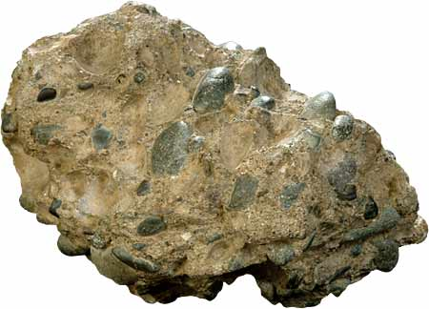
11. Conglomerate

Slide 16
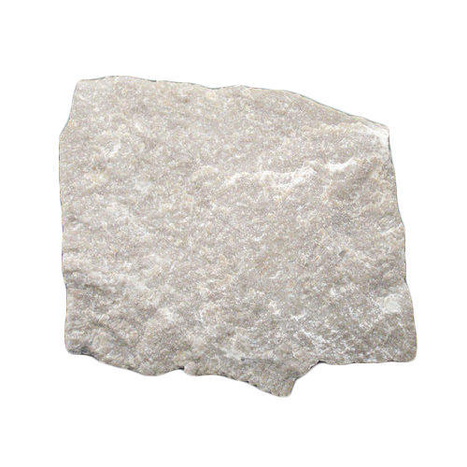
12. Limestone

Slide 17
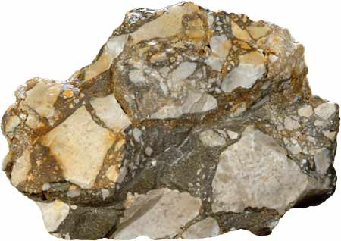
13. Breccia

Slide 18
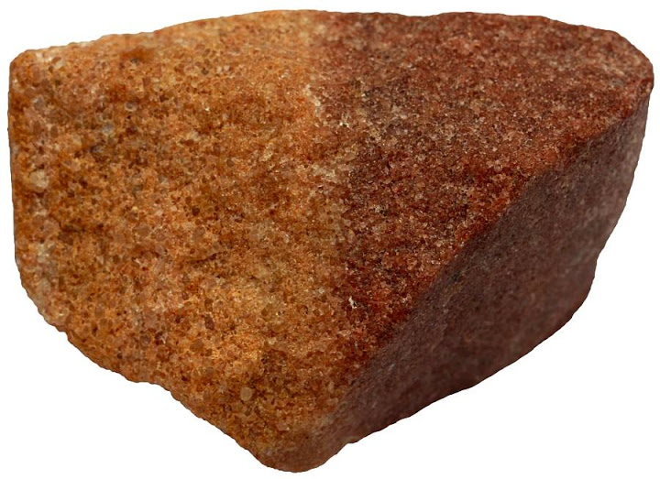
14. Sandstone

Slide 19
Metamorphic Rocks

Slide 20
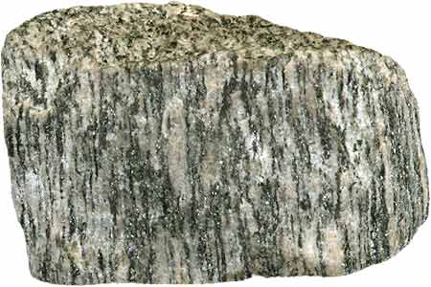
15. Gneiss

Slide 21
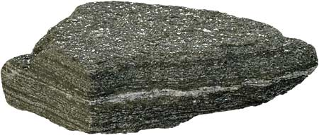
16. Schist

Slide 22
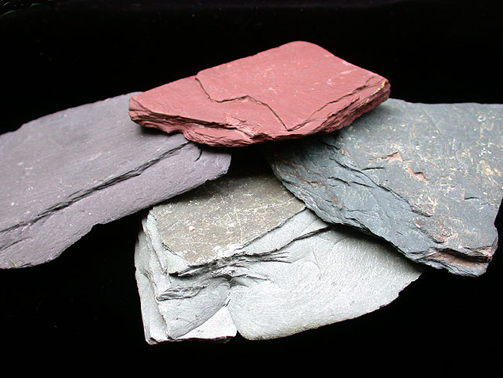
17. Slate

Slide 23
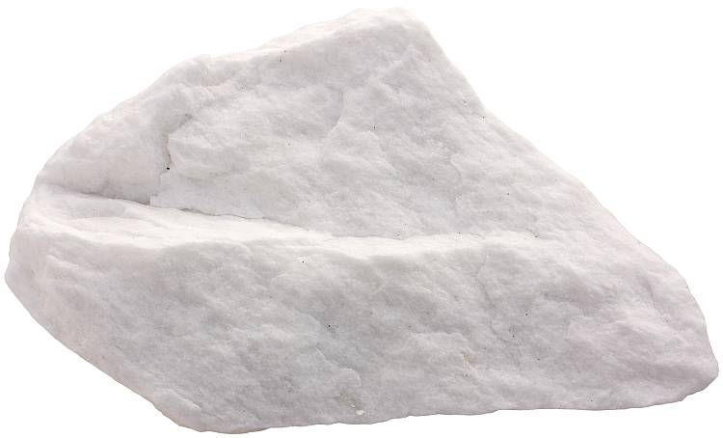
18. Marble

Slide 24
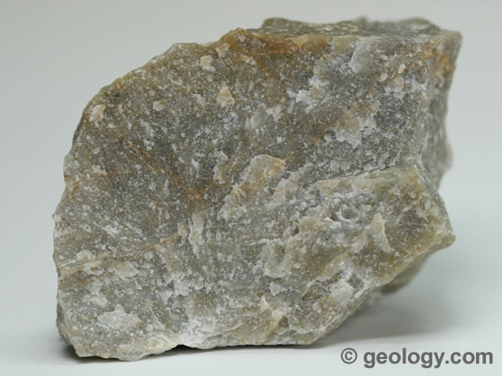
19. Quartzite

Slide 25
On Back of paper

Slide 27
IGNEOUS
INTRUSIVE – large crystals (coarse-grained)
INTRUSIVE – “ “ “ “
INTRUSIVE – “ “ “ “
EXTRUSIVE – no crystals (glassy)
EXTRUSIVE – gas bubbles
EXTRUSIVE – small crystals (fine-grained)
EXTRUSIVE - “ “ “ “

Slide 28
SEDIMENTARY
Chemical
Organic
Clastic
Clastic – rounded pebbles
Chemical or Organic
Clastic – angular sediments
Clastic

Slide 29
METAMORPHIC
Foliated (bands)
Foliated
Foliated
Non-foliated (reacts to acid – contains calcite)
Non-foliated

