Slide 1
MINERALS
Ch. 5

Slide 2
The Chemistry of Minerals Notes

Slide 3
Watch first!
Brainpop video: ATOMS

Slide 4
Atomic Structure
Matter is anything that has mass and volume (takes up space)

Slide 5
Elements
An ELEMENT is a substance that cannot be broken down into simpler substances by ordinary chemical means.
Examples: Hydrogen (H), Carbon (C), Oxygen (O), Iron (Fe)
Symbols:
1 or 2 letters (1st is capital)
Comes from first letters of name (may be Latin or Greek name)

Slide 6
Atoms
An ATOM is a basic unit of an element.
Structure:
Inside the nucleus:
PROTON (positive charge)
NEUTRON (no charge) /neutral charge
Outside the nucleus:
ELECTRON (negative charge)
Electron energy levels (shells)
An atom is usually neutral because: the # of protons = # of electrons

Slide 7
Atomic Number and Mass Number
The ATOMIC NUMBER is # protons or # electrons
The MASS NUMBER is # protons AND neutrons
To determine the number of electrons in an atom: Atomic #
To determine the number of protons in an atom: Atomic #
To determine the number of neutrons in an atom: Mass # - Atomic #

Slide 8
Compounds
A COMPOUND is 2 or more elements bonded together.
Examples: NaCl (salt), H₂O (water), CO₂ (carbon dixoide)
A MINERAL is a naturally occurring, inorganic, solid, with a crystal structure, and definite chemical composition.

Slide 9
Fill in this concept map on the back:
Naturally occurring
solid
Characteristics of a MINERAL (What is a mineral?)
Crystal Structure: arrangement of atoms
Inorganic
Definite chemical composition: chemical formula

Slide 10
MINERALS
Get out a new piece of notebook paper and title it MINERALS.
YOU WILL WRITE EVERYTHING FROM THIS POINT ON SO DON’T ASK IF YOU HAVE TO WRITE SOMETHING!!!

Slide 11
What are minerals made of?
Minerals are made of crystals!
Crystal – regular geometric solid with smooth surfaces called crystal faces. (atoms arranged in a pattern)
The crystal structure will affect the minerals solid form, cleavage, hardness, and density.
Brainpop video: CRYSTALS

Slide 12
How are minerals formed?
Magma rises, cools, atoms move close together, and form compounds.
Pressure on minerals is so great, change without melting, then form new minerals.

Slide 13
How do we identify minerals?
By looking at their properties:
(Now you are going to switch over to writing on your foldable that you cut out THURSDAY! You will glue your foldable into your notebook)

Slide 14
Color
Some minerals have distinct colors to help identify them. BUT it is the LEAST useful property.
Ex. Sulfur - yellow

Slide 15
One Mineral, many colors

Slide 16
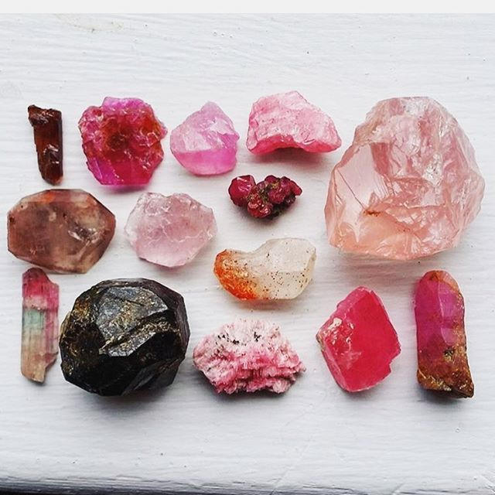
Different Mineral, same colors

Slide 17
Streak
The color of the minerals POWDER. Tested by rubbing the mineral on an unglazed white or black ceramic tile, called a streak plate.
Ex. Pyrite (gold color) but it has a black/green streak.

Slide 18
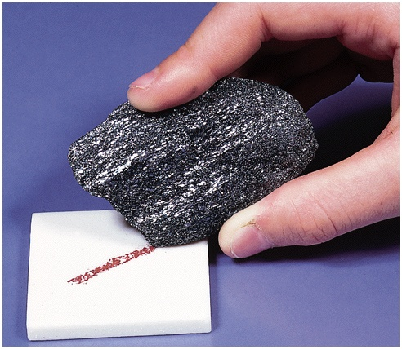
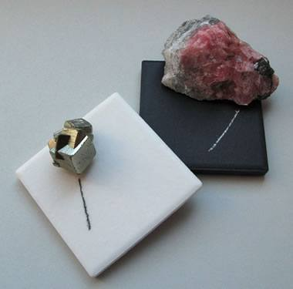
Streak

Slide 19
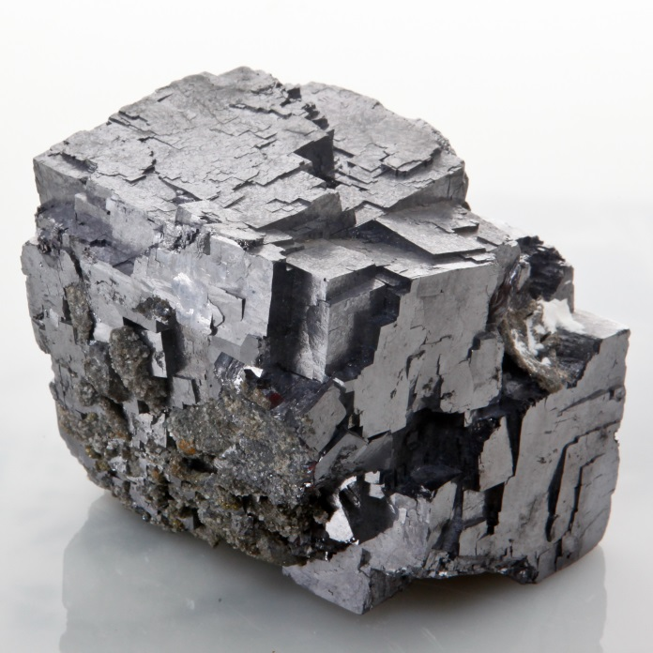
Luster
This is the way light is reflected off the surface of the mineral.
Metallic – shines like polished metal.
Non-metallic – shines like glass, pearly, diamond, or can be greasy, oily, dull, or earthy.
Ex: Galena

Slide 21
Luster

Slide 22
Luster

Slide 23
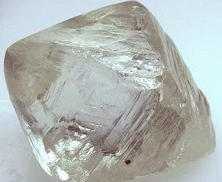
Hardness
This is the ability of the mineral to resist scratching. Mohs Scale of Hardness is the scale used to determine the hardness of a mineral.
Ex Talc: softest & Diamond: hardest

Slide 25
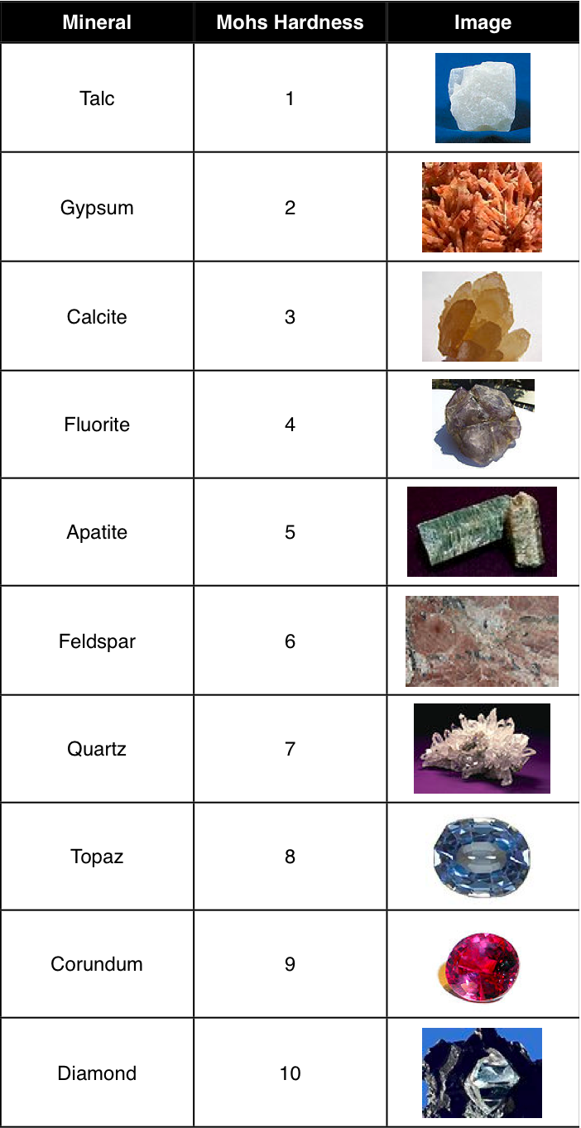

Slide 26
Density
D=mass/volume
Each mineral has its own characteristic density.

Slide 27
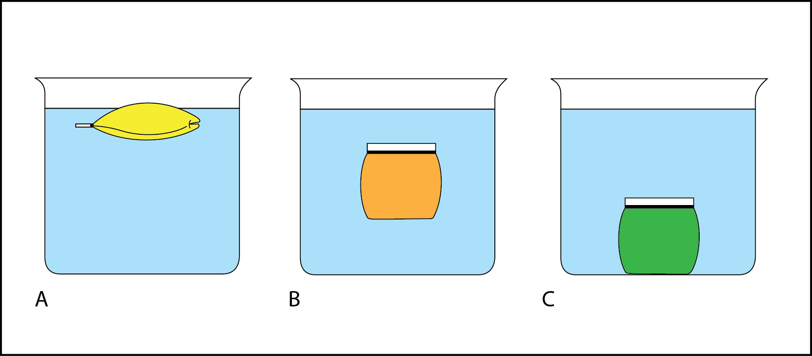
Density

Slide 28
Cleavage
The ability of a mineral to break along definite planes or directions. (Breaks into sheets or nice even shapes)
Ex: halite breaks into cubes
Ex: mica splits into sheets

Slide 29
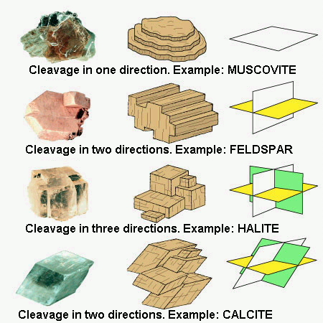
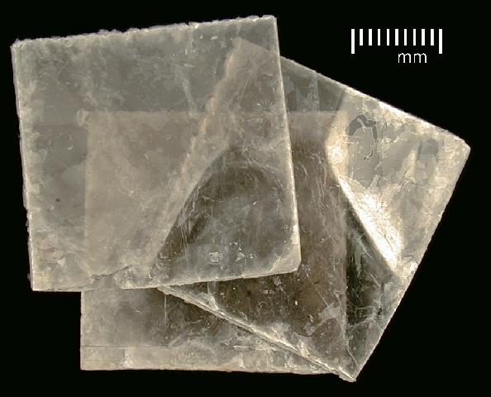
Cleavage

Slide 30
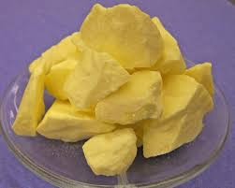
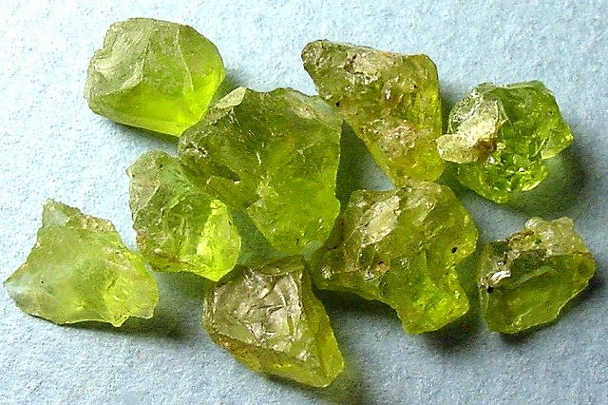
Fracture
When a mineral breaks in no specific plane or direction. Rough/uneven edges
Ex: Quartz

Slide 31
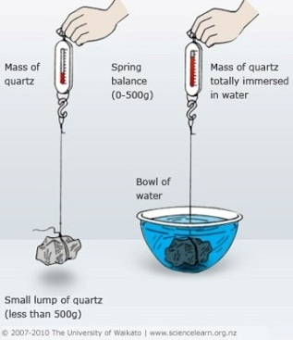
Specific Gravity
Comparing the ratio of a minerals mass in air to the minerals mass in water. This tells you how many times denser the mineral is than water.

Slide 32
Special Properties
Fluorescence – appears to glow under UV light
Ex: fluorite
Taste – ex: halite (salt)
Magnetism – mineral is magnetic
(ex: magnetite)
Radioactive – emit subatomic particles, can be detected by a Geiger counter.
Acid Test – mineral is exposed to acid, CO₂ bubbles are released, appear to fizz
(Ex: calcite)

Slide 33
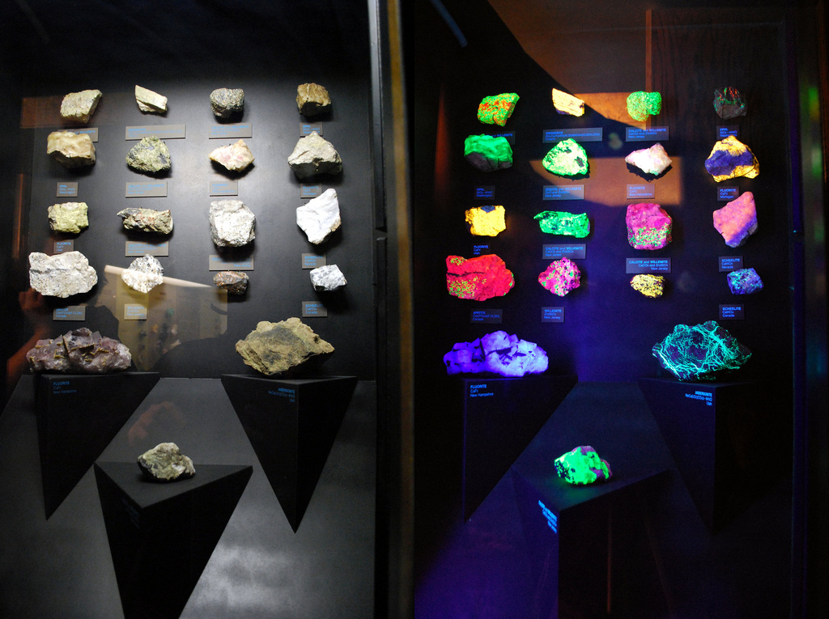
Fluorescence

Slide 34
Recap:
Brainpop: Mineral Identification

