Slide 1
Volcanoes
Ch. 9

Slide 2
I. What is a volcano?
A Volcano is an opening in Earth’s crust through which molten rock (lava), gases, and ash erupt, and the landform that develops around it.

Slide 3
II. Why Volcanoes form:
Volcanic Eruptions occur when magma rises to the surface. This will happen when the asthenosphere melts enough to flow. There are three things that can cause this:
1- Decrease in pressure, lowers melting point, Like at a Mid-Ocean Ridge or Rift Valley
2- Increase in temperature causing materials to melt. Like at a Hot Spot
3- An increase in the amount of water in the asthenosphere, Like at a Subduction Zone

Slide 4
Where Volcanoes Form
1. Divergent Boundaries
2. Convergent Boundaries that have subduction.
3. Hot Spots

Slide 5
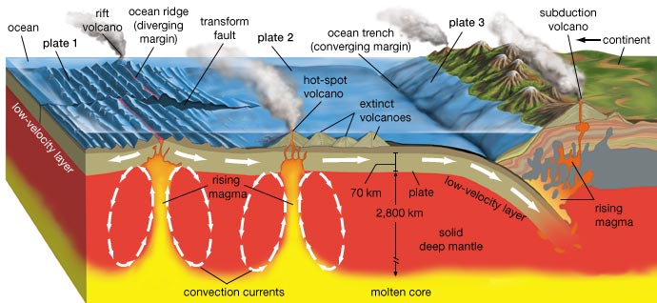

Slide 6
1. Volcanoes at Divergent Boundaries
Decrease in pressure as plates spread apart, lets magma rise and make new crust
EXAMPLES: Mid-Atlantic Ridge & Great African Rift Valley

Slide 7
2. Volcanoes at Convergent Boundaries (Subduction)
Subducting plate increases the amount of water in the asthenosphere, which lowers the melting temp.
As the subducting crust is pushed lower, it melts into magma.
•When continental and oceanic plates converge, a volcano forms on land.
•When 2 oceanic plates converge together, a volcano forms an island arc.

Slide 8
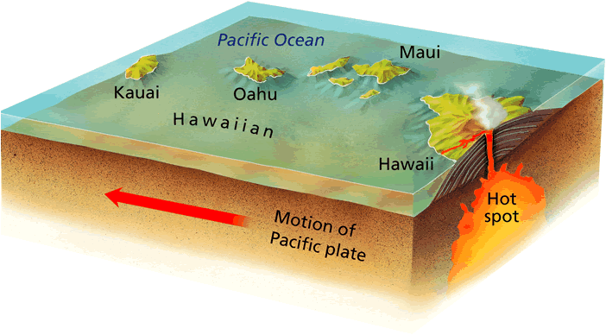
3. Volcanoes at Hot Spots
Sometimes, volcanoes occur at places that aren’t plate boundaries. We call these HOT SPOTS.
Hot spots are areas of volcanic activity that result from plumes of hot solid material that have risen from deep within the Earth’s mantle.
Magma escapes where the crust is the weakest.
Example: Hawaiian Islands

Slide 9
Characteristics of Magma:
Viscosity – resistance to flow
Silica Content - Silica is the principal ingredient in all magma
High amounts of silica resist flow
Low amounts of silica flow easier

Slide 10
hotter magmas are less viscous (flow easier)
more silica in lava = more viscous
granite has more silica & is more viscous
dissolved gases (usually CO2 & H2O) that can easily escape & expand at surface reduce viscosity
more viscous lava impedes escape of expanding gases & eruption is more violent

Slide 11
Types of Magma
Granitic Magma
 | Basaltic Magma | Andesitic Magma | Rhyolitic Magma
Silica Content
Gas Content
Viscosity
Type of Eruption
Melting Temperature
Location
Examples

Slide 12
Volcanic eruptions and Lava

Slide 13
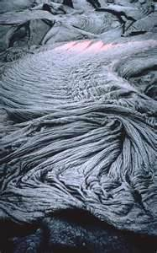
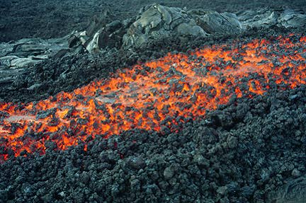
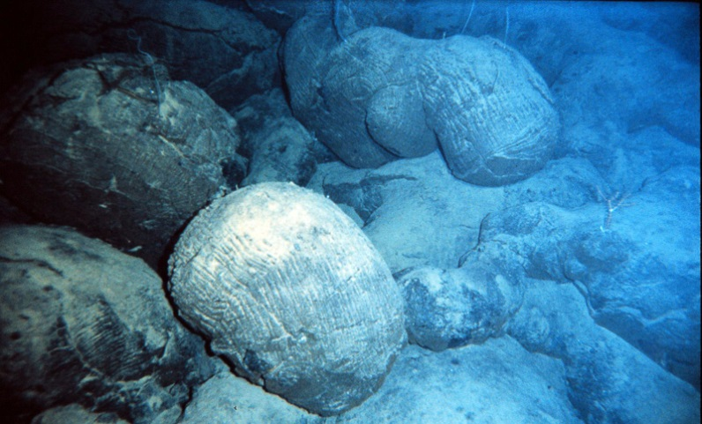
Lava Types:
Pahoehoe – looks like rope braids (slow cooling)
Aa – rough jagged blocks (quick cooling)
Andesite – “sticky mud”
Pillow Lava - cools underwater and forms a rounded pillow shape rock

Slide 14
Factors that determine eruption violence:
1. Magma composition - hotter basaltic magmas are less damaging than cooler granitic magma
2. Temperature - hotter lavas are usually less viscous and easier to extrude
3. Dissolved gases in lava - more dissolved gases provide more force to extrude molten rock from vent

Slide 15
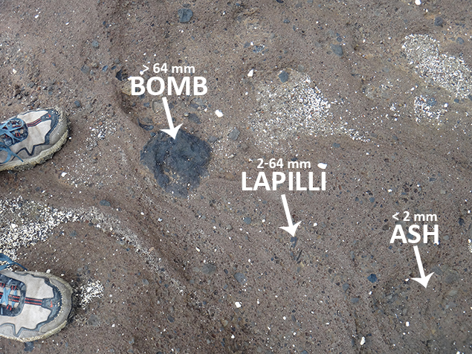
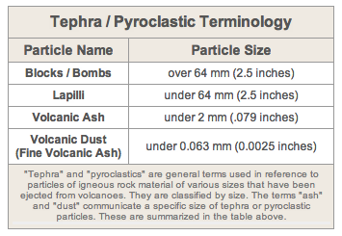
Tephra
the material that is blown out of a volcano and into the air during a violent eruption. This is also known as pyroclastic material. There are 5 general categories of tephra that are primarily separated according to size (smallest to largest): Volcanic Dust, Volcanic Ash, Lapilli, Volcanic Blocks, and Volcanic Bombs.

Slide 16
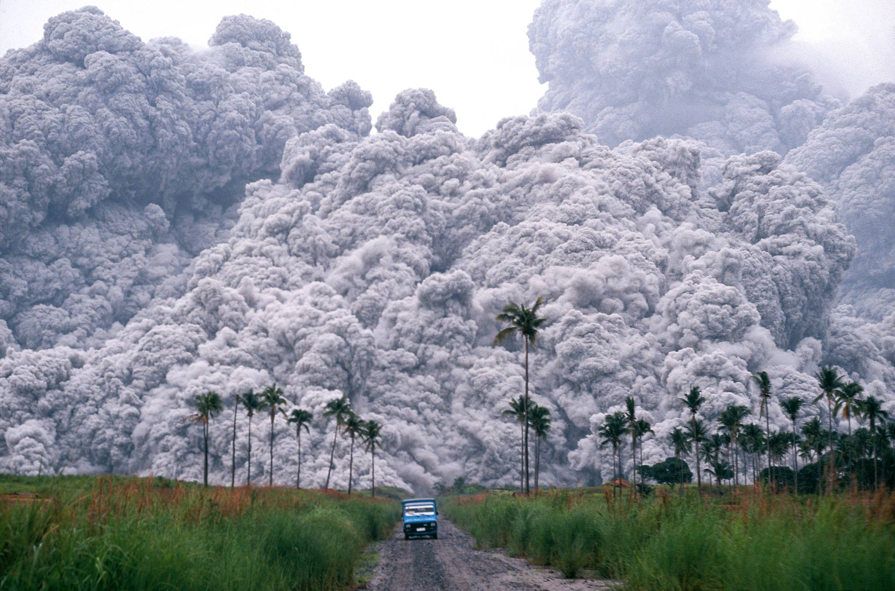
Pyroclastic flows
are high-density mixtures of hot, dry rock fragments and hot gases that move away from the vent that erupted them at high speeds (hundreds of miles per hour).
Mt. Pinatubo

Slide 18
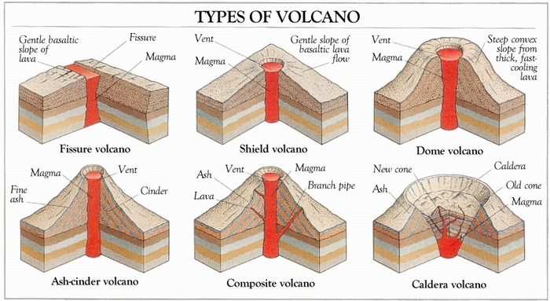

Slide 19
Shield Volcanoes:
Shield Volcanoes form from runny lava (low viscosity) that tends to flow long distances before hardening. They generally have “quiet” eruptions.
Volcano has gently sloping sides and a broad base.
Lava flows more easily, low gas content.
Type of magma: basaltic
Example: Hawaiian Islands: Mount Kiluea, Mauna Loa

Slide 20
Cinder Cones:
Form when molten lava is thrown into the air from a vent. As it falls, it breaks into fragments called ash or tephra that harden before hitting the ground.
The Ash and Tephra make a cone shape around the vent.
Eruption style: mildly explosive
Example: Paricutin, Mexico

Slide 21
Composite or Stratovolcano:
Form from alternating eruptions of quiet lava and explosive ash. The layers build up and make a moderate-sized volcano.
Example: Mt. St. Helens, Mt. Rainier, Mt. Fuji

Slide 22
Fissure Volcanoes:
Form in linear vents where plates are pulled apart and near other volcanoes where the crust is weakened. Cinder Cone or shield Volcanoes may also be nearby.

Slide 23
Caldera Formation:
A) A Volcano’s pressure starts to build up
B) The Volcano releases large amounts of Lava
C) As the Lava is released, the pressure decreases and the volcanic mountain begins to collapse, forming a concave shape in the center of the volcano.
D) The center of the volcanic mountain may begin to fill with water and form a lake. (Crater Lake in Oregon should actually be called Caldera Lake!)

Slide 24
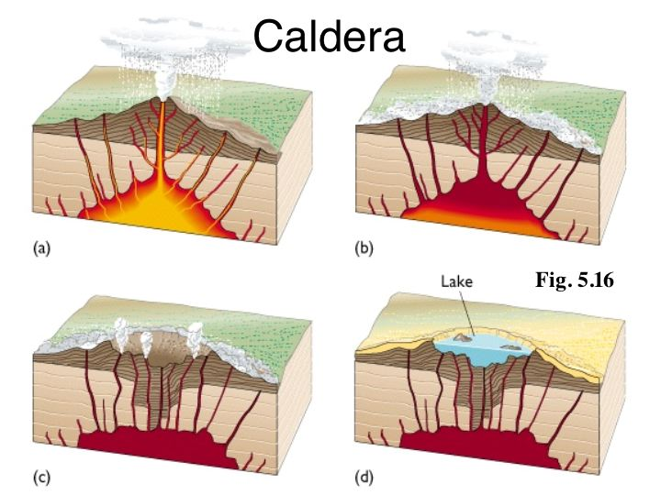

Slide 25
Terms to describe volcanoes:
Dormant - volcanoes haven’t erupted in a long time, but they could again.
Extinct - volcanoes haven’t erupted for thousands of years and might be dead.
Active - volcanoes, on the other hand, erupted recently, and they’re probably going

Slide 26
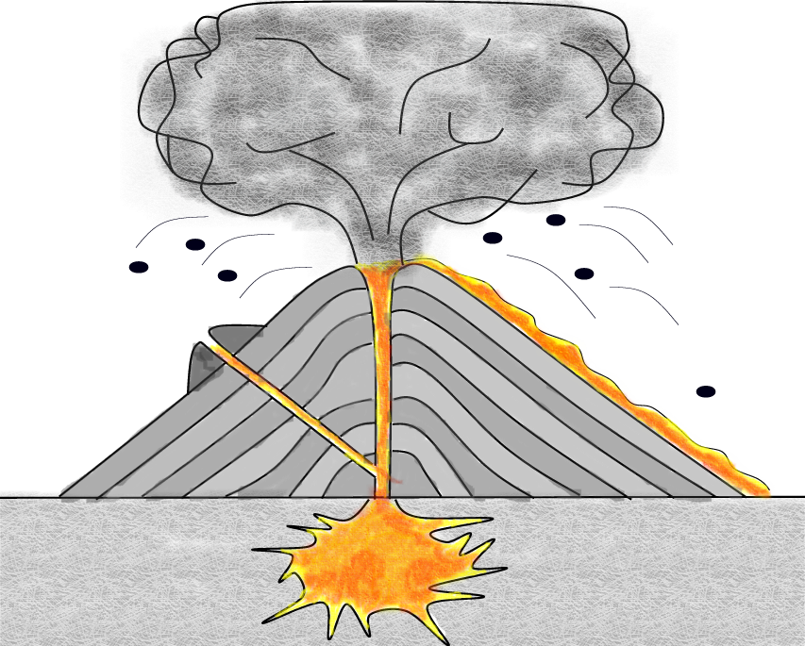
Label the parts of the Volcano
Ash & dust cloud
crater
Main vent
Tephra bomb
Secondary vent
Lava
Conduit
Magma chamber

