Slide 1
Minerals
Ch. 5

Slide 2
MATTER
Anything that has mass and volume.
Mass – measure of the amount of material in an object or substance.
Volume – the amount of space taken up by an object or substance.

Slide 3
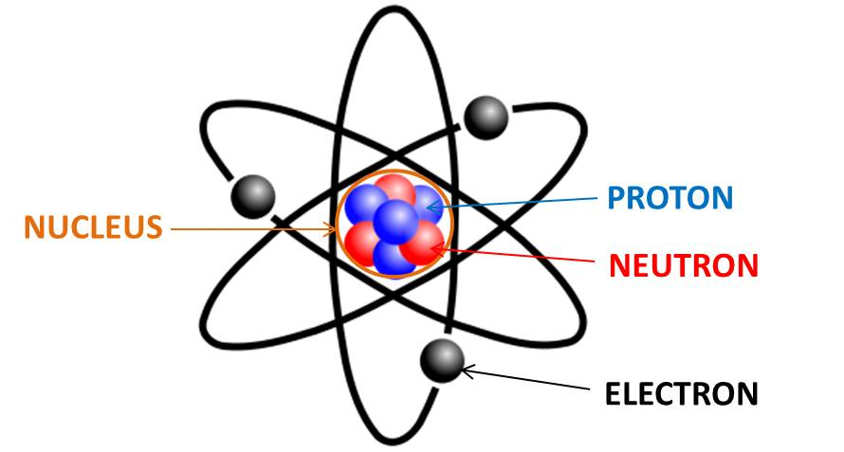
Atom:

Slide 4
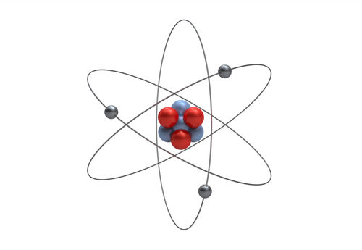
Element
substance that cannot be broken into simpler substances by ordinary chemical means.

Slide 6
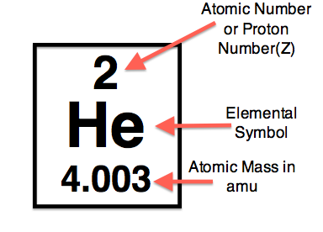
Understanding the Periodic Table

Slide 7
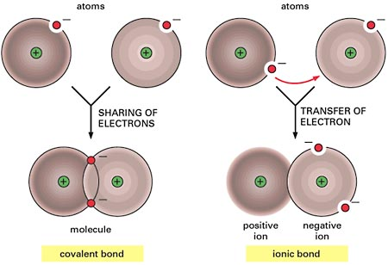
BONDS

Slide 8
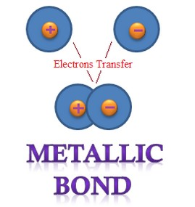
BONDS

Slide 9
MINERALS

Slide 10
What is a mineral?
A mineral has 5 characteristics:
Occurs naturally (not man made)
Solid
Has definite chemical composition (chemical formula) (ex: water = H20)
Atoms are arranged in an orderly pattern (crystal structure)
Inorganic (never alive)

Slide 11
What are minerals made of?
Minerals are made of crystals!
Crystal – regular geometric solid with smooth surfaces called crystal faces. (atoms arranged in a pattern)
The crystal structure will affect the minerals solid form, cleavage, hardness, and density.

Slide 12
How are minerals formed?
magma rises, cools, atoms move close together, and form compounds.
Pressure on minerals is so great, change without melting, then form new minerals.

Slide 13
How do we identify minerals?
By looking at their properties:
Color
Streak
Luster
Cleavage
Fracture
Hardness
Specific gravity

Slide 14
Color
Some minerals have distinct colors to help identify them. BUT it is the LEAST useful property.
Ex. Sulfur - yellow

Slide 15
One Mineral, many colors

Slide 16
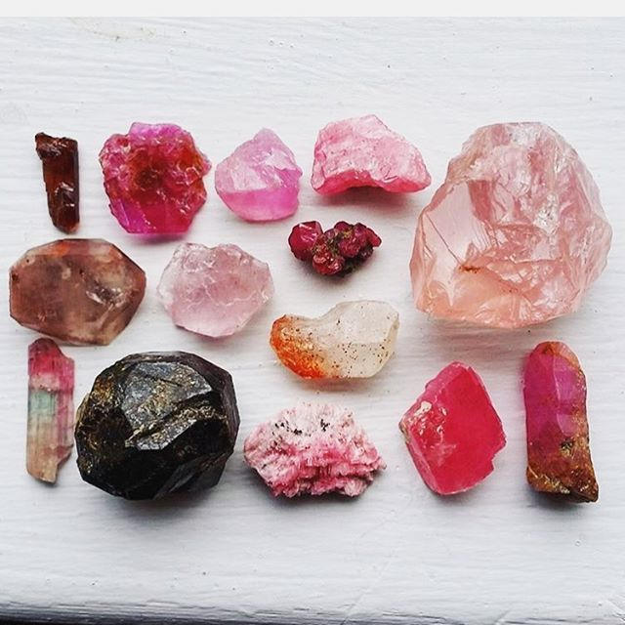
Different Mineral, same colors

Slide 17
Streak
The color of the minerals POWDER. This is tested by rubbing the mineral on an unglazed white or black ceramic tile, called a streak plate.
Ex. Pyrite (gold color) but it has a black/green streak.

Slide 18
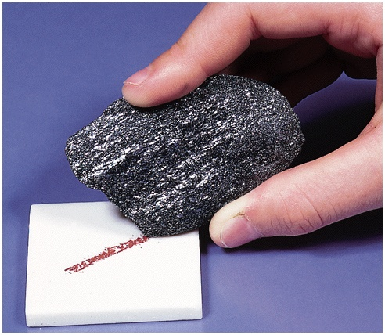
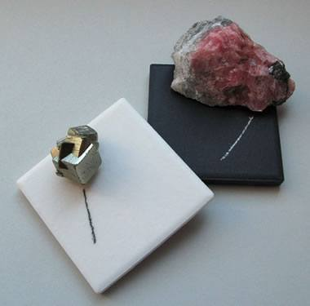
Streak

Slide 19
Luster
This is the way light is reflected off the surface of the mineral.
Metallic – shines like polished metal.
Non-metallic – shines like glass, pearly, diamond, or can be greasy, oily, dull, or earthy.
Ex: Galena

Slide 21
Luster

Slide 22
Luster

Slide 23
Hardness
This is the ability of the mineral to resist scratching. Mohs Scale of Hardness is the scale used to determine the hardness of a mineral.
Ex Talc: softest & Diamond: hardest

Slide 25
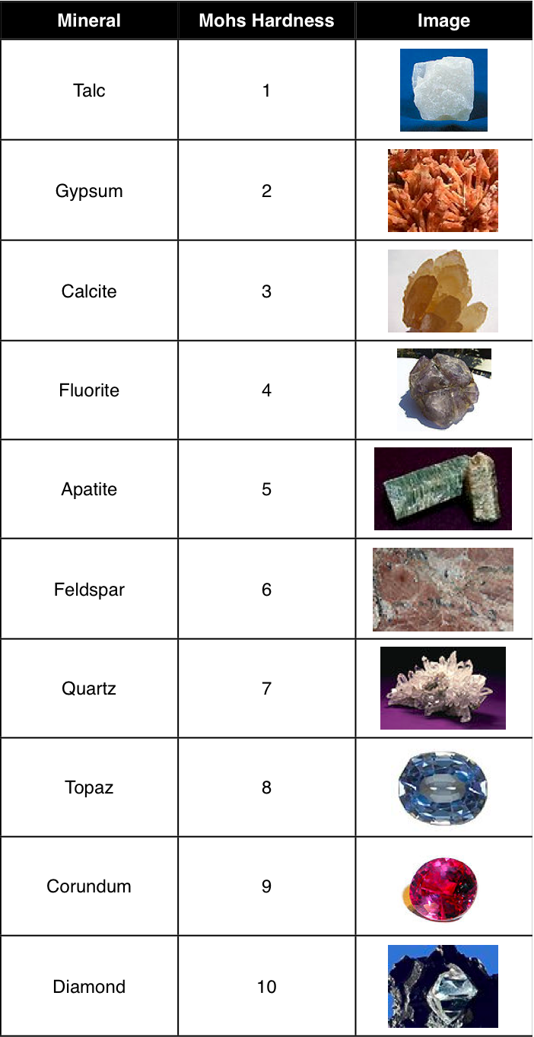

Slide 26
Density
D=mass/volume
Each mineral has its own characteristic density.
Does a mineral float or sink in water?

Slide 27
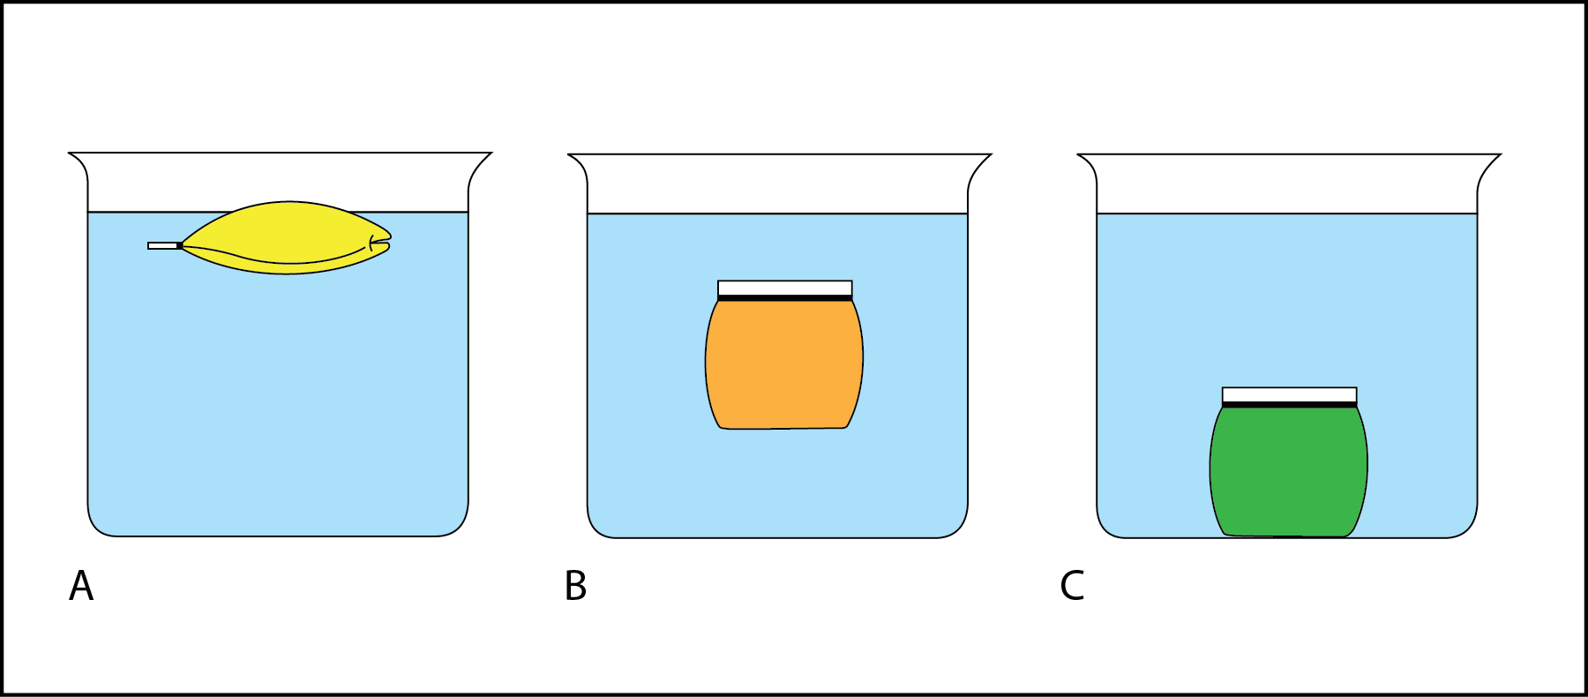
Density

Slide 28
Cleavage
The ability of a mineral to break along definite planes or directions. (Breaks into sheets or nice even shapes)
Ex: halite breaks into cubes
Ex: mica splits into sheets

Slide 29
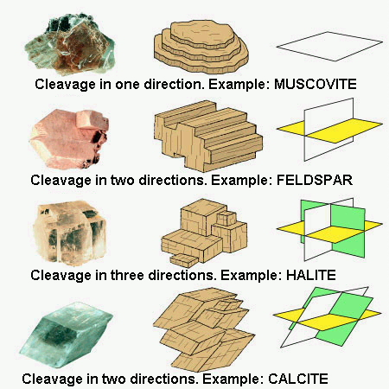
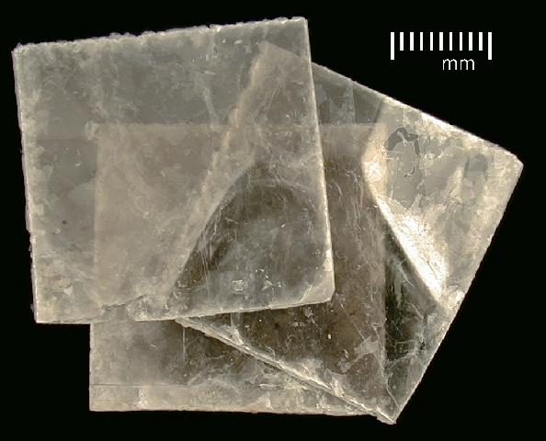
Cleavage

Slide 30
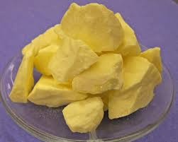
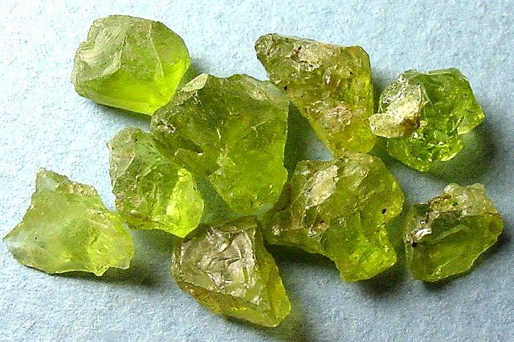
Fracture
When a mineral breaks in no specific plane or direction. Rough/uneven edges
Ex: Quartz

Slide 31
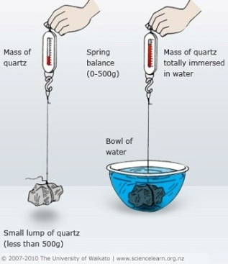
Specific Gravity
Comparing the ratio of a minerals mass in air to the minerals mass in water. This tells you how many times denser the mineral is than water.

Slide 32
Special Properties
Fluorescence – appears to glow under UV light
Ex: fluorite
Taste – ex: halite (salt)
Magnetism – mineral is magnetic
(ex: magnetite)
Radioactive – emit subatomic particles, can be detected by a Geiger counter.
Acid Test – mineral is exposed to acid, CO2 bubbles are released, appear to fizz
(Ex: calcite)

Slide 33
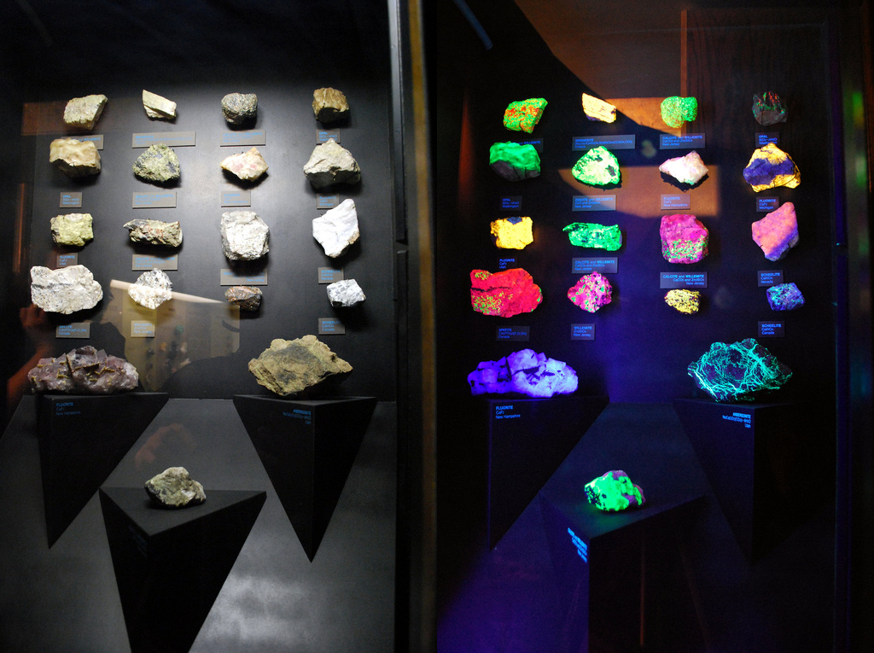
Fluorescence

Slide 34
Mineral Groups
There are 7 groups that minerals are classified into:
Silicates
Sulfides
Sulfates
Carbonates
Oxides
Native elements
Halides

Slide 35
Mineral Groups
The most abundant chemical elements in the Earth's crust and mantle are: Oxygen (O), Silicon (Si).
Silicate minerals - Most abundant mineral group, make up about 90% of the Earth’s surface. These minerals contain silica (Si⁴⁺) and oxygen (O²⁻)
Ex: Quartz

Slide 36
Mineral Groups
Important Non-Silicate Mineral groups:
Oxides - all contain oxygen (O) and a metal
Ex: hematite/iron ore, magnetite/iron ore, corundum/industrial abrasive
Sulfides - all contain sulfur (S)
Ex: galena/lead ore, pyrite/'fools gold')
Sulfates - all contain sulfur and oxygen (SO₄)
Ex: gypsum/plaster

Slide 37
Mineral Groups
Native Elements - minerals that are made of only one type of element.
Ex: gold, copper, diamond, sulfur, graphite, silver, platinum
Halides - all contain halogen ions, such as chlorine (Cl), Bromine (Br), Fluorine (F), and Iodine (I).
Ex: Halite/common table salt, Fluorite/steel hardener
Carbonates - all contain carbon, oxygen, and a metal (CO₃)
Ex: calcite/cement

Slide 38
How Do Minerals Form?
From molten rock (Magma)
Magma rises from deep in the Earth
As it begins to cool, atoms begin moving closer together
Over time they group together and form minerals

Slide 39
How Do Minerals Form?
From Pressure
Minerals break down under high heat and pressure
Temperature and pressure gets high enough to change the rock without melting it
Atoms recombine in new ways to form new minerals

Slide 40
Mineral Importance
An ore is a type of rock that contains sufficient minerals with important elements including metals that can be economically extracted from the rock.
The ores are extracted from the earth through mining; they are then refined (often via smelting) to extract the valuable element, or elements.

Slide 41
Ore Minerals
Pyrite
Magnetite
Hematite
Galena
Graphite
Sulfur

