Slide 1
Ch. 2/3 Review
Scientific Method
Density
Maps

Slide 2
A student set up an experiment to test the effects of soil compaction on plant growth. The student put equal weights of moist soil into 10 containers, planted a bean seed one inch deep in each container, and then firmly compacted the soil in 5 of the containers. After the seeds sprouted, the student measured the height of each plant every day and kept a record of the results. What else must the student do over time to ensure a valid experiment?
Water the plants in compacted soil more than those in uncompacted soil
Water any of the plants that seem to be growing more slowly than the others
Water all of the containers the same amount and at the same time
Water any container in which the soil feels dry

Slide 3
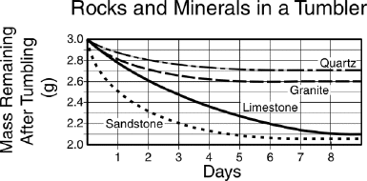
How much limestone was worn away between Day 1 and Day 2?
2.3 grams
0.2 gram
2.8 grams
2.5 grams

Slide 4
Which would be the best tools to measure the density of a small piece of silver ore?
A metric ruler and a metal detector
A barometer and a balance
A graduated cylinder and a balance
A density probe and a 500 mL beaker

Slide 5
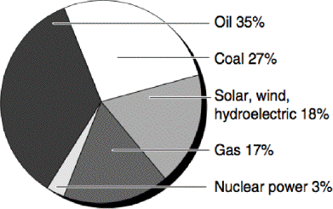
The chart above shows different sources of energy. Which conclusion can be made based on this chart?
Renewable energy sources are predominantly used.
Use of nuclear power is increasing.
Fossil fuels make up over three-quarters of our energy consumption.
Coal is the main source of energy.

Slide 6
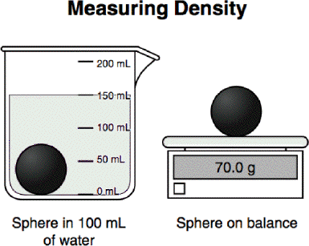
In the first picture, the sphere is in a beaker with 100 mL of water. In the second picture, the dry sphere is being massed. Which of the values listed is closest to the density of the black sphere?
0.7 g/mL
0.5 g/mL
2.1 g/mL
1.4 g/mL

Slide 7
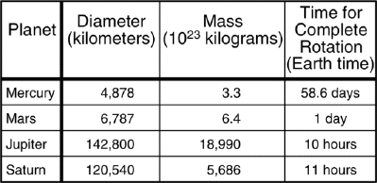
Which planet rotates the fastest?
Saturn
Mercury
Mars
Jupiter

Slide 8
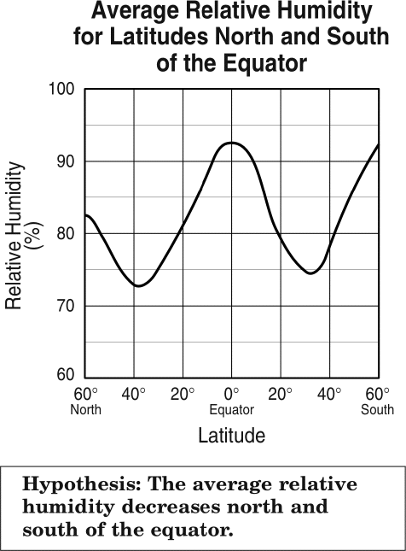
According to the data shown in the graph, the hypothesis is only correct for latitudes –
between 20° and 60° from the equator
farthest from the equator
from the poles to 40° from the equator
up to 40° from the equator

Slide 9
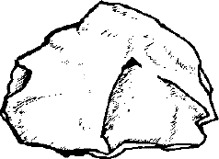
A student found the rock shown below and weighed it to determine its mass. What steps should the student take to find its density?
Determine its volume using the formula for the volume of a sphere (V=43πr3), then divide mass by volume
Determine its volume by how much water it displaces, then divide mass by volume.
Determine its volume by multiplying length × width × height, then divide mass by volume
Crush the rock to a powder and measure its volume with a graduated cylinder, then divide mass by volume.

Slide 10
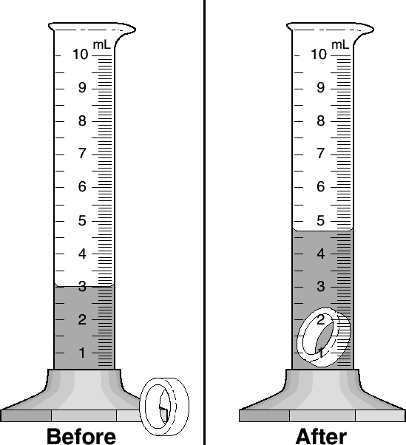
One step in determining the metal content of a ring is to find the volume of the ring. What is the volume of this ring?
Answer: 1.7ml

Slide 11
Which of the following is part of a valid process for supporting a hypothesis?
Experimentation
Single trials
Limited research
Altering results

Slide 12
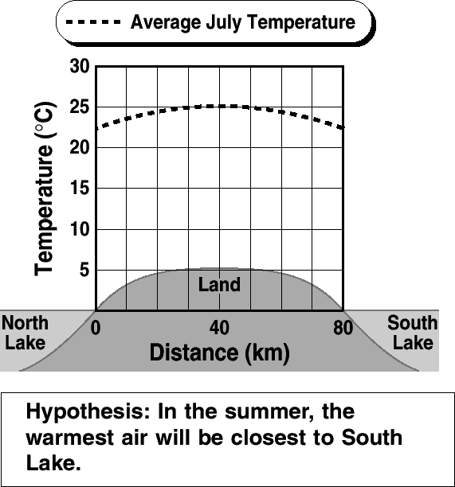
According to the data shown by the graph, the warmest air during the summer will be found -
above the land between the lakes
closest to the water level of the lakes
above South Lake
closest to North Lake

Slide 13
A student claims that the full Moon occurs about once a month. What process will verify the student's claim?
Predicting
Theorizing
Observing
Hypothesizing

Slide 14
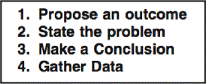
Put the steps of a scientific experiment in the correct order?
Answer: 2,1,4,3

Slide 15
What is the main disadvantage to map projections?
Mountains get flattened on a map so that mountainous areas look larger than they really are.
The northern regions are enlarged because the shallower parts of the oceans are frozen.
The latitude and longitude lines create an optical illusion.
The map is a projection of a round world onto a flat surface.

Slide 16
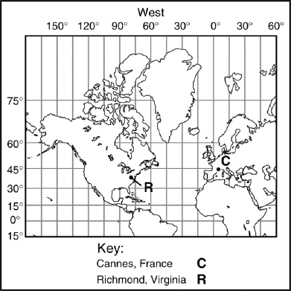
What is the approximate coordinates for the city of Richmond?
Answer:
40˚N, 80˚W

Slide 17
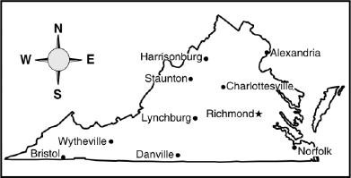
In what direction is Staunton from Richmond?
Northeast
Northwest
Southeast
Southwest

Slide 18
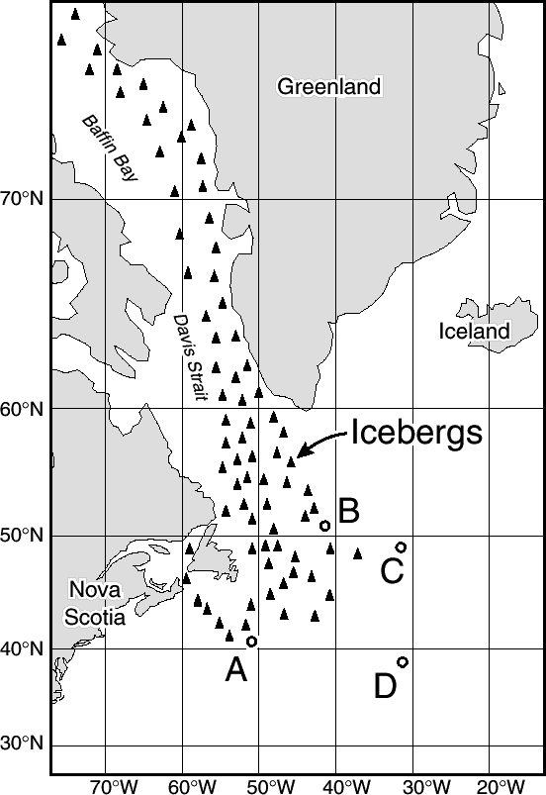
The wireless operator aboard the Titanic signaled for help and gave the ship's location as 41°45'N and 50°14'W. Which area shown on the map is most likely where the Titanic struck the iceberg?
Answer: A

Slide 19
Which coordinates identify a location north of a city that has a latitude of 38.0°N and a longitude of 25.0°W?
47.0°N and 25.0°W
25.0°N and 38.0°W
0.0° and 0.0°
38.0°N and 47.0°W

Slide 20
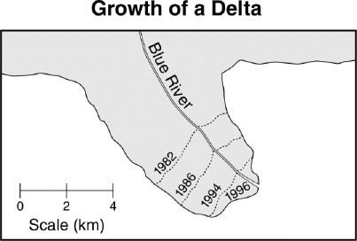
By how much has the length of the delta increased from 1982 to 1996?
2 km
4 km
6 km
8 km

Slide 21
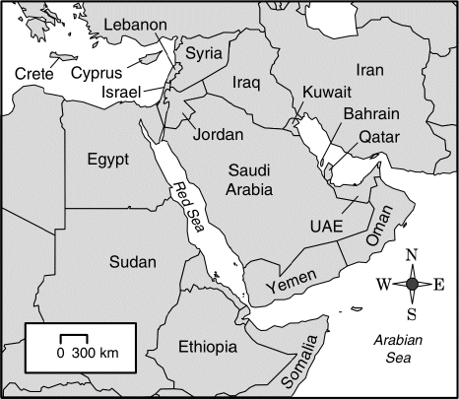
About how long is the Red Sea?
40 km
1200 km
2100 km
300 km

Slide 22
STOP

Slide 23
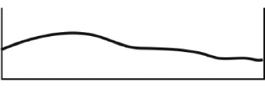
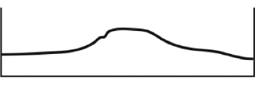
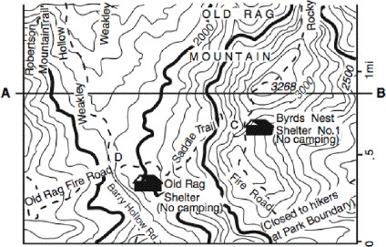
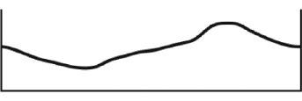
Which profile best represents the contour map along the line AB?

Slide 24
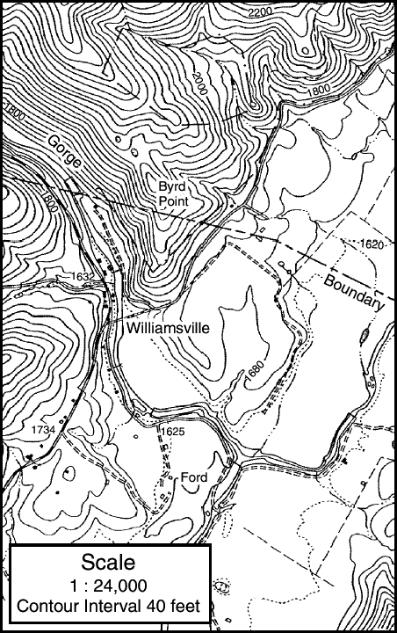
What is the actual distance represented by 1 inch on this map?
24 feet
40 feet
12,000 inches
24,000 inches

Slide 25
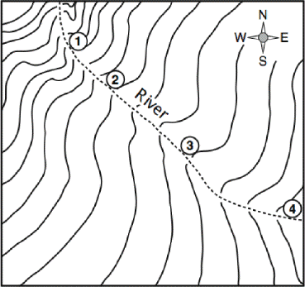
The river shown on the topographic map flows fastest at point –
1
2
3
4

Slide 26
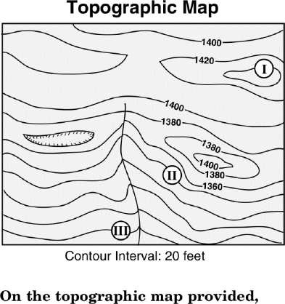
On the topographic map provided, what is the elevation of point III?

Slide 27
The topographic map that may show a hill with a volcanic crater/depression:

Slide 28
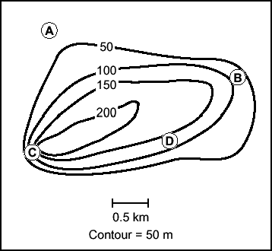
What area of the map has the steepest slope?

