Slide 1
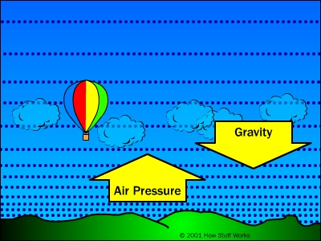
Air Pressure
Can you feel it?

Slide 2
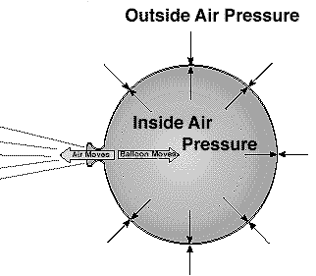
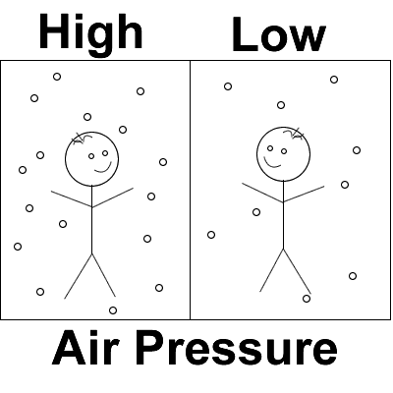
Air Pressure
Air pressure is the measure of the force with which air molecules push on a surface.
Air Pressure is GREATEST at the surface of Earth because there is more of the atmosphere above you to push down on you.

Slide 3
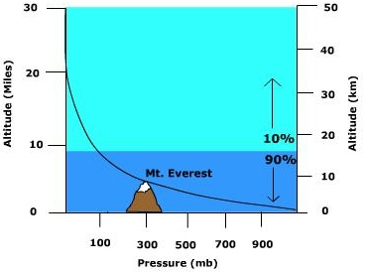
As you move UP through the atmosphere, air pressure decreases.

Slide 4
What is the air pressure at an altitude of 10 km? ______________
What is the air pressure at an altitude of 30 km? ______________

Slide 5
Air Pressure is dependant on DENSITY
More dense air will have a higher air pressure- there are more air molecules in a given space to push down on you
Less dense air will have a lower air pressure- there are fewer air molecules to push down on you.
More Dense= more particles to push down on you
Less Dense= fewer particles to push down on you

Slide 6
Air Pressure is affected by 3 factors
1- Elevation, or altitude
2- Temperature
3- Water content (HUMIDITY)

Slide 7
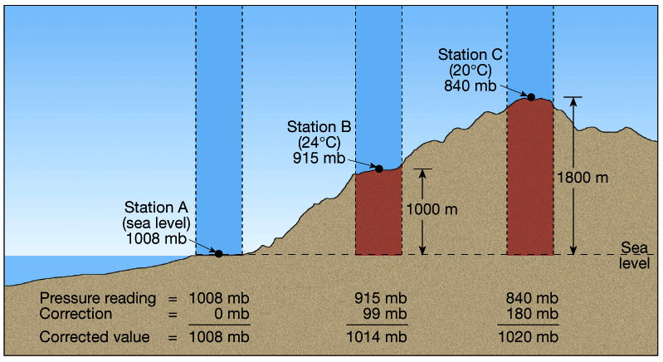
Impact of Elevation on Air Pressure
As you move up through the atmosphere, air pressure decreases.
There are fewer air molecules above you to push down on you, so the force of the air will be less.

Slide 8
Impact of Water Content, or humidity, on Air Pressure
Moist air is less dense than dry air, and therefore has a lower air pressure.
A water molecule has less mass than other molecules that make up the air. If you replace some of the air molecules with water molecules, the water lowers the density (and lowers the air pressure)
O
N
H2O
N
Weighs less since H2O is lighter than Nitrogen and Oxygen
O
N
O
H2O

Slide 9
Impact of Temperature on Air Pressure
Warm air is less dense than cold air. Therefore, warm air has a lower air pressure and cold air has a higher air pressure.
The molecules in warm air are moving fast and are spread farther apart. Therefore there are fewer air molecules in a given area to push down on you.
Warm
Air
Cold Air

Slide 10
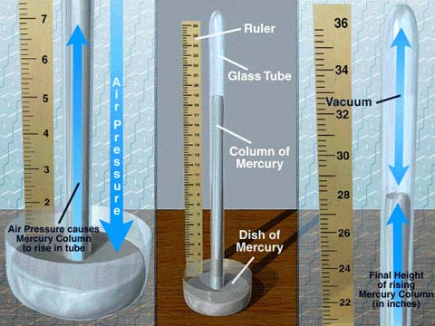
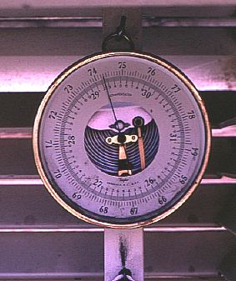
Barometer
The piece of equipment used to measure air pressure is a Barometer
Aneroid Barometer
Mercury Barometer

Slide 11
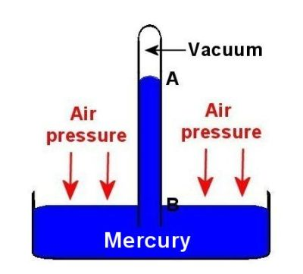
Mercury Barometer

Slide 12
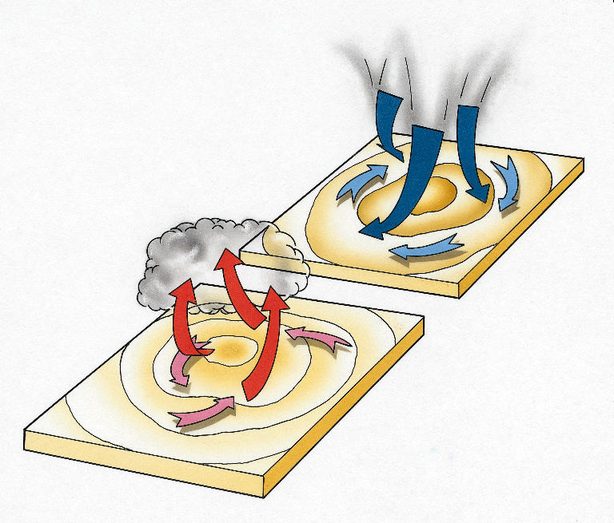
Air Pressure Affects the Weather
Air pressure in a weather system reflects the amount of water in the air, which affects the weather.
Low air pressure usually results in Bad weather: stormy, cloudy, overcast.
High air pressure usually results in Good weather: clear skies, no precipitation

Slide 14
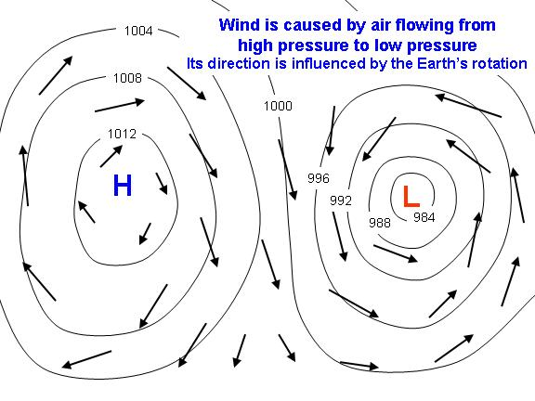

Slide 15
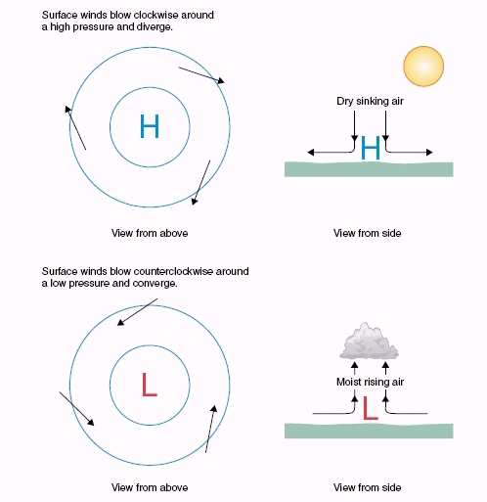

Slide 16
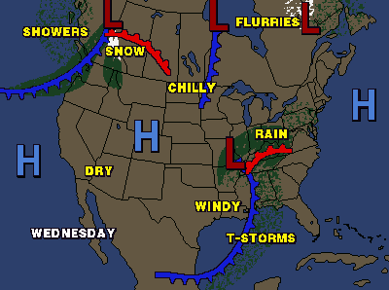
Air Pressure on a Weather Map
Areas of High and Low pressure on shown on a weather map with an H or an L.

