Slide 1
Earth’s Atmosphere
Ch. 17

Slide 2
Layers

Slide 4
Troposphere
Lowest layer, closest to surface.
Weather occurs here.
Contains 70-80% of the total mass of atmosphere & 99% of water vapor.

Slide 5
Stratosphere
Temperature increases as altitude increases
Planes/weather balloons fly in this area
Contains Ozone layer (ozone molecules) - protects us from UV radiation.

Slide 6
Mesosphere
Middle layer
Temperature decreases with altitude.
Meteors burn up in this layer.

Slide 7
Thermosphere
Temp increases with altitude
Air density is low
Northern lights – auroras
Contains the ionosphere

Slide 8
Exosphere
the uppermost layer, where the atmosphere thins out and merges with interplanetary space
Very thin air/space like – mainly Hydrogen & Helium
Satellites orbit here

Slide 10
Heat transfer

Slide 11
Insolation
Incoming solar radiation

Slide 12
Heat Transfer

Slide 13
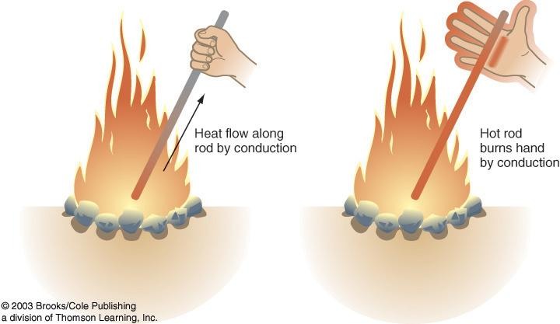
Conduction
The transfer of heat by the heat source and object directly touching.

Slide 14
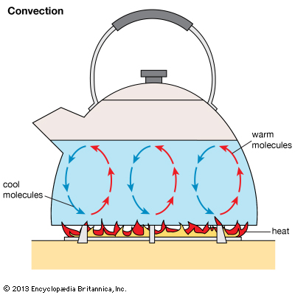
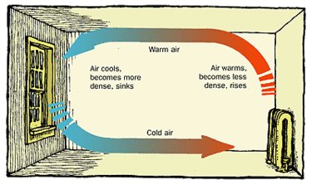
Convection
Movement caused within a fluid by the tendency of hotter, less dense material to rise, and colder, denser material to sink under the influence of gravity, which results in transfer of heat.

Slide 15
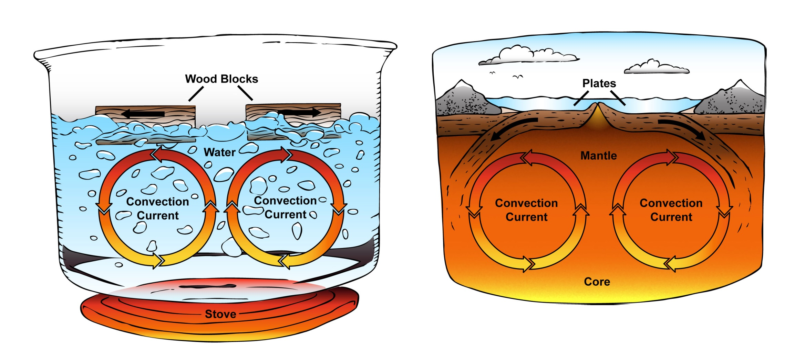
Convection
THINK CURRENT!!!!!

Slide 16
Radiation
Heat transfer due to emission of electromagnetic waves is known as thermal radiation.
Heat transfer through radiation takes place in form of electromagnetic waves mainly in the infrared region.
Radiation is moving out from source in ALL directions.

Slide 17
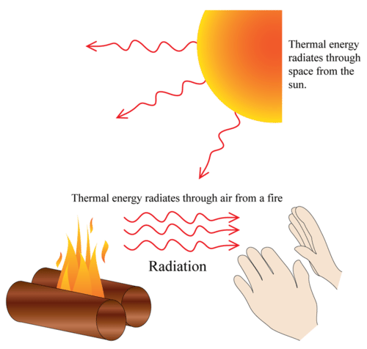
Radiation

Slide 18
What affects temperature to change on earth?

Slide 19
Local Temperature Variations
How does sunlight cause temperature to change?
Angle of insolation
Time of day
Latitude
Time of year
Cloud cover

Slide 20
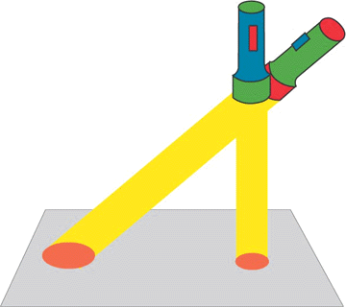
Local Temperature Variations
Angle of insolation

Slide 21
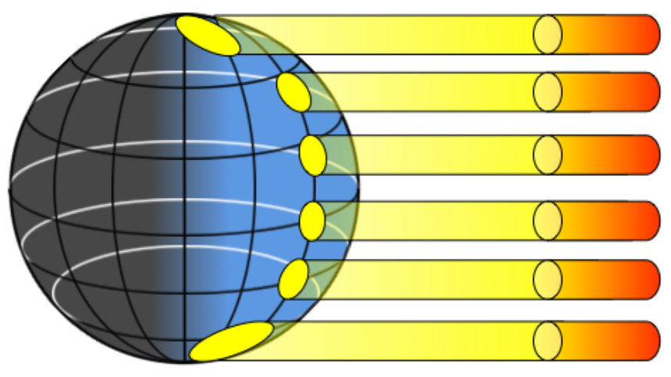

Slide 22
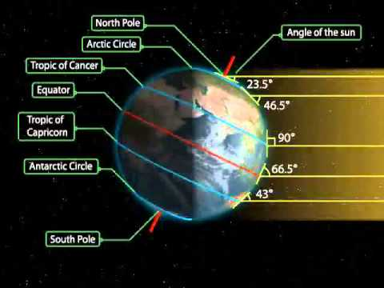
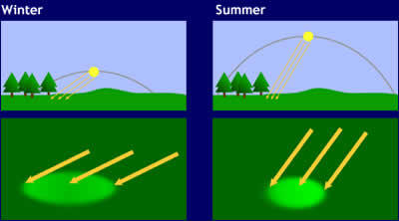
Latitude
Time of year

Slide 23
Difference between LAND and WATER
Which one heats faster?
LAND
Which one loses heat faster?
LAND

