Slide 1
Ch. 14 Groundwater

Slide 2
The WATER TABLE
cone of depression

Slide 3
Water Table
Area where the zone of saturation and zone of aeration meet. (CAN CHANGE)
water table

Slide 4
Zone of aeration
Between the water table and the surface, section of ground that holds some water.

Slide 5
Zone of saturation
Part of ground where all pore spaces are filled with water.

Slide 6
Capillary fringe
Zone where water rises because the water molecules are attracted to soil.

Slide 7
Impermeable layer
Layer of rock where water cannot enter.

Slide 8
Perched aquifer
Forms on top of an impermeable layer that lies above the water table.

Slide 9
Spring
Small stream of water whose source is groundwater that has reached the surface.

Slide 10
Ordinary well
Well that contains water up to the level of the water table.

Slide 12
Artesian formation
When an aquifer dips underground between impermeable rock layers. Like a “sandwich”. Puts pressure on layers.

Slide 13
Aquifer
Permeable layers of rock and sediment that store groundwater and supply wells

Slide 14
Artesian well
Well dug to access the pressurized water between the impermeable rock layers. Pressure pushes water out of ground.

Slide 15
Impermeable cap rock
Upper impermeable layer of an artesian formation. Usually shale.

Slide 16
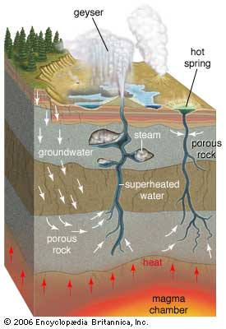
Hot Springs
Groundwater heats at great depths and rises through cracks and fissures.

Slide 17
Geyser
Hot spring that intermittently shoots columns of hot water and steam into air due to pressure.

Slide 18
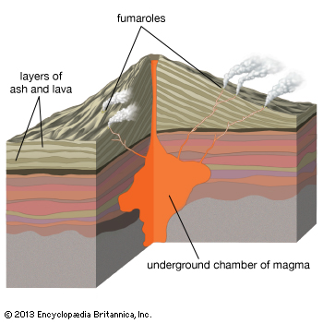
Fumarole
Groundwater is released as steam from fissures in the ground (usually from fairly recent volcanic eruptions)

Slide 19
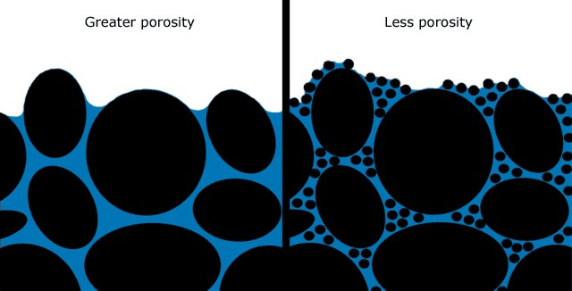
Porosity
The % of a materials volume that is pore space. This is the EMPTY space in rock/holes in rock.

Slide 20
Porosity
A soil of high porosity means that there is a great deal of air space between soil particles.

Slide 21
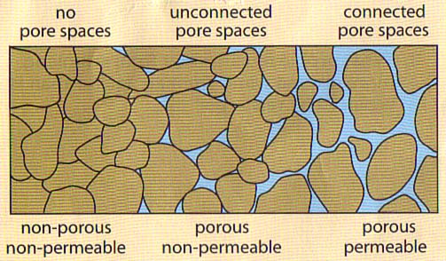
Permeability
Rate at which water or liquids can pass through the pore spaces of rock.
In order for WATER to PASS THROUGH ROCK, the PORE SPACES must be CONNECTED!

Slide 23
Capillary Action
Tendency of liquids to rise UP through a material, such as sediments.

Slide 24
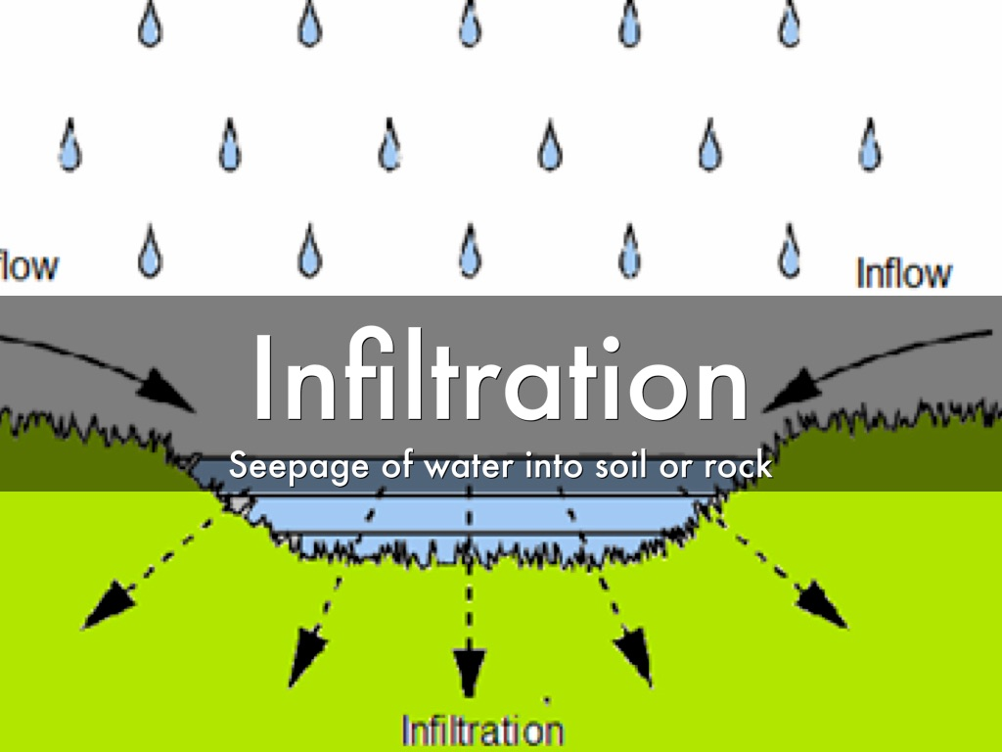
Infiltration
Process when water enters the ground through cracks in the rock.

