Slide 1
Asteroids, Meteoroids, Comets
Ch. 27

Slide 2
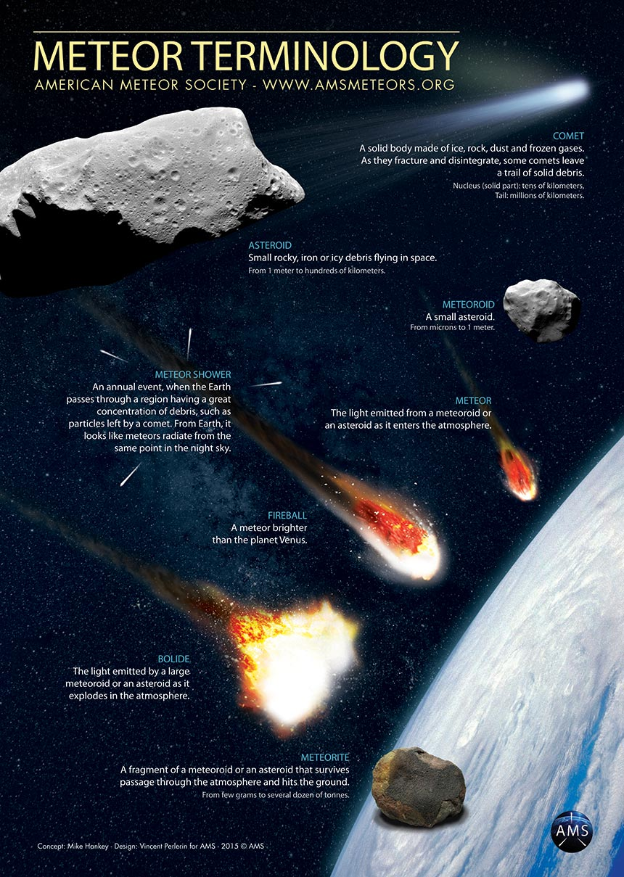

Slide 3
What are some characteristics of Asteroids?
Orbit the sun.
Made of rock/metal.
Mainly found in the Asteroid Belt between Mars and Jupiter.
Smaller than moons, larger than meteoroids.
Irregularly shaped, pitted/cratered.
Believed an asteroid impact, 65 million years ago caused dinosaur extinction.

Slide 4
ASTEROIDS
The first asteroid was discovered in 1801 by Italian astronomer Giuseppe Piazzi.
Named Ceres, it is approximately 600 miles wide.

Slide 5
What are some characteristics of Meteoroids?
Meteoroid – small rock/debris in the solar system.
Meteor – a meteoroids that burns up as it goes through the earth’s atmosphere. (shooting star)
Meteorite – a meteoroid that hits the earth’s surface.

Slide 6
METEOROIDS
Approximately 500 meteorites reach the Earth’s surface every year but of those only around 5 ever make it to scientists for study.
The Earth’s atmosphere experiences millions of meteors every day.
When many meteors occur in a close time frame in the same part of the sky it is called a meteor shower.

Slide 7
What are some characteristics of Comets?
Loose collections of ice, dust, gases (ammonia/methane), small rocky particles (dirty snowball)
Orbit sun in long narrow ellipses
Found in Kuiper Belt/Oort Cloud
Contain: nucleus, coma, tail
As it approaches sun, heats up and gas/dust stream outward forming a tail which points AWAY from the sun.

Slide 8
COMETS

Slide 9
Describe where you can find a meteor
Burning up in earth’s atmosphere (mesosphere).

Slide 10
Describe where you can find a meteorite
On the earth’s surface.

Slide 11
Describe where you can find a meteoroid
Floating freely in space.

