Slide 2
Bodies in the solar system; orbit the Sun.
Typically made of rock and metal but can also contain organic compounds.
Made of materials left over from the formation of the solar system.

Slide 3
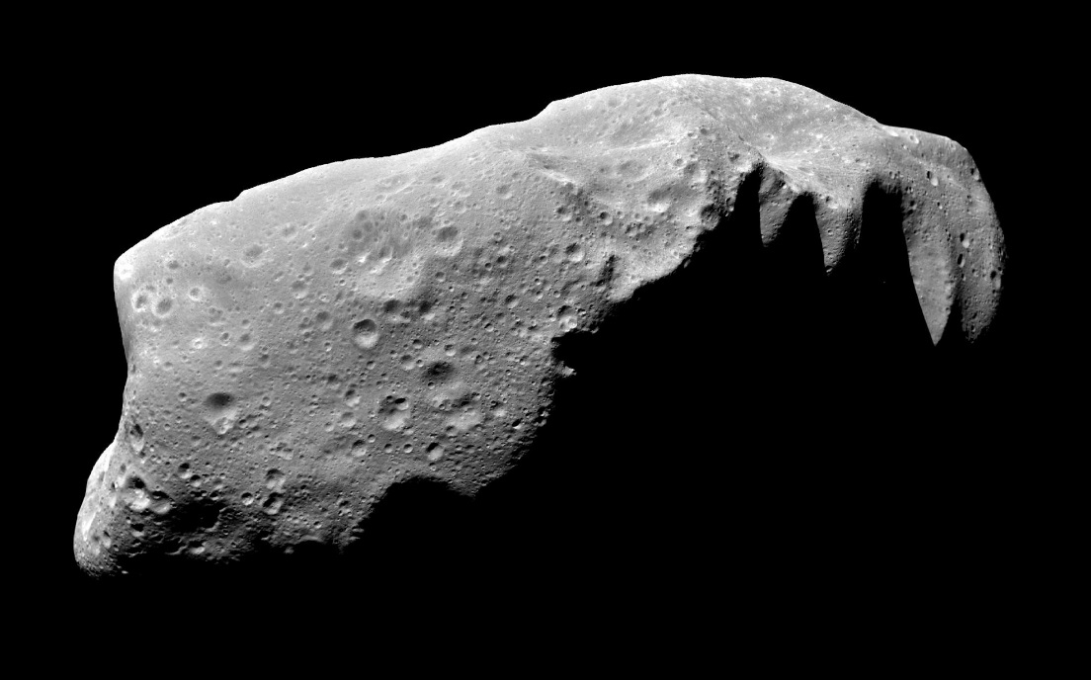
Vary greatly in size and can be as large as hundreds of miles wide.
Similar to comets but do not have a coma (tail) that is visible.

Slide 4
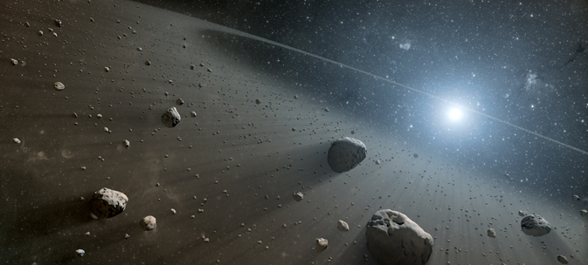
Most orbit the Sun between Mars and Jupiter, although some orbit closer. (Asteroid Belt)

Slide 5
The asteroid belt is divided into an inner belt and an outer belt.
The inner belt, is made up of asteroids that are within 250 million miles of the Sun, contains asteroids that are made of metals.
The outer belt, includes asteroids 250 million miles beyond the Sun, consists of rocky asteroids.

Slide 6
The first asteroid was discovered in 1801 by Italian astronomer Giuseppe Piazzi.
Named Ceres, it is approximately 600 miles wide.

Slide 7
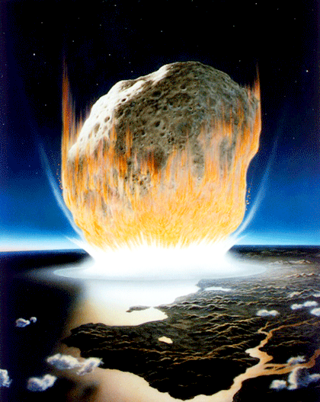
Many scientists believe that an asteroid impact was the cause behind the extinction of the dinosaurs around 65 million years ago.

Slide 8
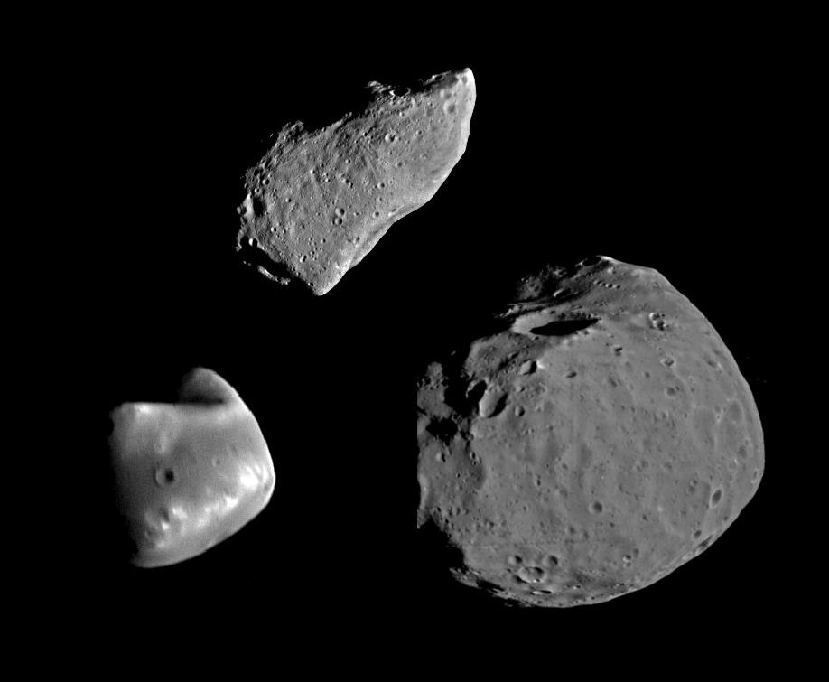
Meteoroid- small rock or particle of debris in the solar system.
Range in size from dust to around 10 meters in diameter.
Larger objects are referred to as asteroids.

Slide 9
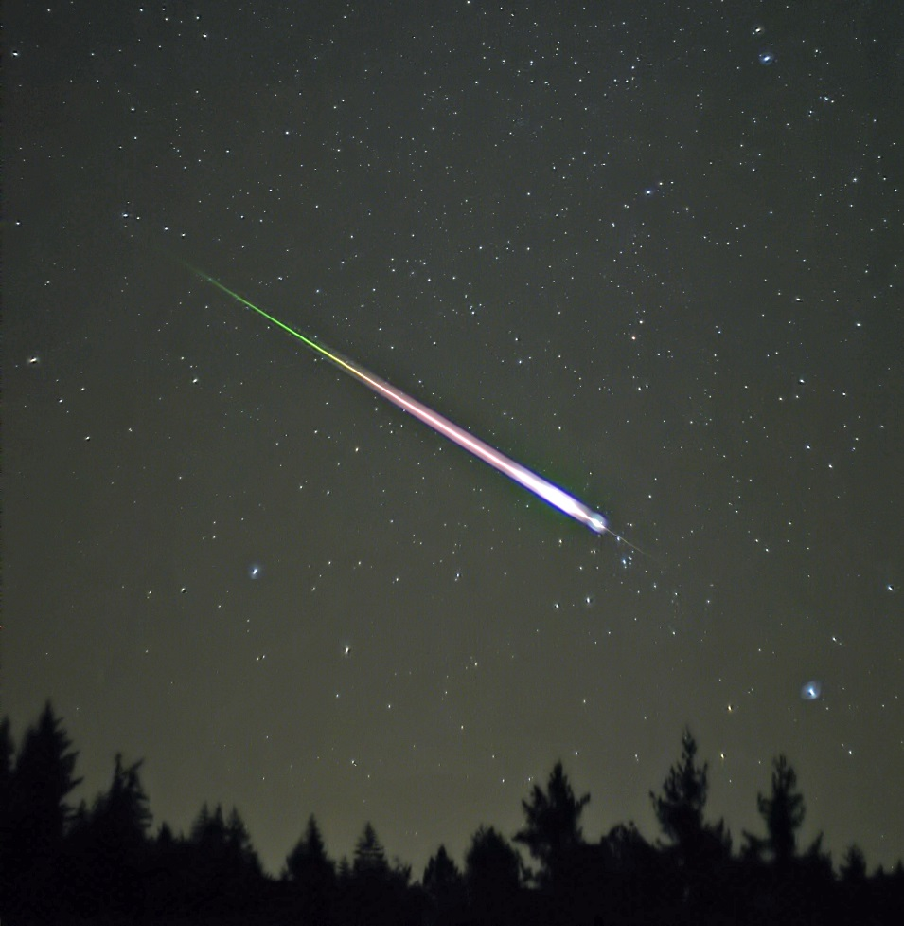
Meteoroids often enter the Earth’s atmosphere.
Meteor - a meteoroid that burns up as it goes through the Earth’s atmosphere.
(Shooting Star) – light that is made as meteoroid passes through the atmosphere.

Slide 10
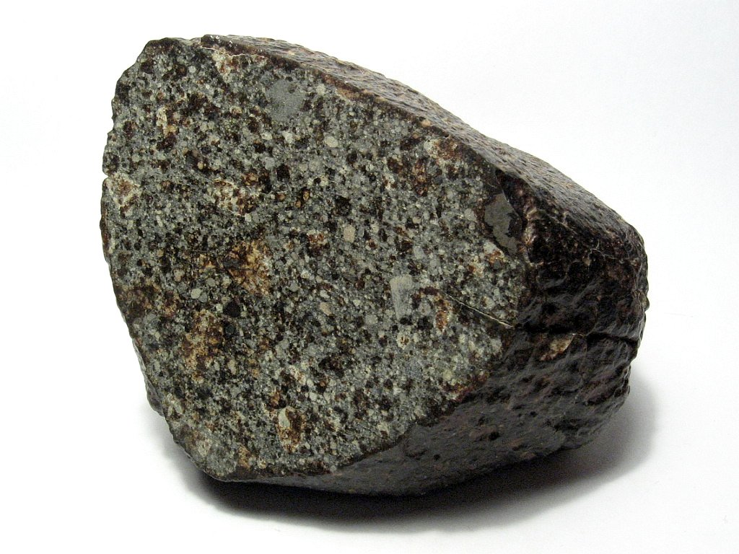
Meteorite - a meteoroid that survives falling through the Earth’s atmosphere and hits the Earth’s surface.

Slide 11
Approximately 500 meteorites reach the Earth’s surface every year but of those only around 5 ever make it to scientists for study.
The Earth’s atmosphere experiences millions of meteors every day.
When many meteors occur in a close time frame in the same part of the sky it is called a meteor shower.

Slide 12
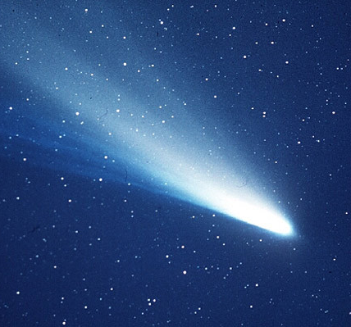
A small solar system body that orbits the Sun.
Comets are made of ice, dust and small rocky particles.
When close enough to the Sun they display a nucleus, coma (a fuzzy outline or atmosphere due to solar radiation) and sometimes a tail (that always points away from sun).

Slide 13
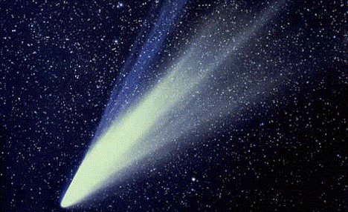
The coma is created as the comet gets closer to the Sun, causing water, carbon dioxide and other compounds to quickly change from solid to gas.

Slide 14
Halley’s Comet is the most well known comet.
It is known as a periodic comet (or short term comet) because the time it takes to orbit the Sun is less than 200 years.
Humans have been observing and recording the comet for thousands of years, with appearances noted by Babylonian, Chinese and European civilizations.
It can be seen from Earth every 75 to 76 years, and since it last appeared in in 1986 it will return again sometime in 2061.

Slide 15
Describe where you can find a meteor
Burning up in earth’s atmosphere.

Slide 16
Describe where you can find a meteorite
On the earth’s surface.

Slide 17
Describe where you can find a meteoroid
Floating freely in space.

